Slide 1
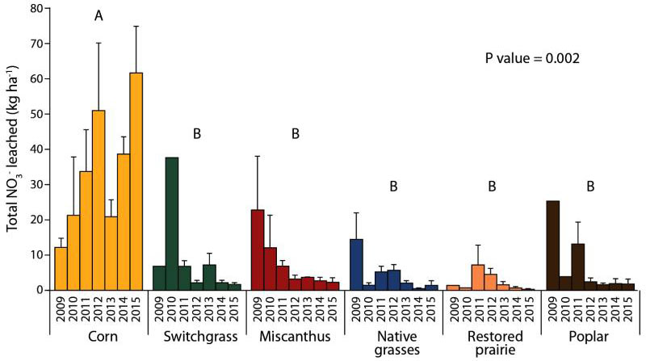
BRC Science Highlight
Nitrate leaching in perennial systems compare favorably to corn crops over time
Objective
Compare nitrate (NO₃⁻) leaching of perennial crops to corn over a seven-year period between 2009 and 2016.
Approach
Soil water was sampled from below the root zone using suction cup samplers between 2009 and 2016.
Leaching was estimated from measured nitrate concentrations in soil water and modeled drainage rates.
Annual summaries represent crop years (harvest to planting) beginning with 2009 harvest
Total nitrate leached in six cropping systems measured (kg N ha⁻¹ yr⁻¹).
Result/Impacts
Over the seven-year period, perennial grasses and poplar trees leached much less nitrate than corn.
Nitrate leaching from grasses and poplar was comparable with corn for 1–2 years after planting.
Perennial cropping systems can reduce nitrate pollution in agricultural landscapes.
M.Z. Hussain, et al. “Nitrate Leaching from Continuous Corn, Perennial Grasses, and Poplar in the US Midwest.” Journal of Environmental Quality (2019). [DOI: 10.2134/jeq2019.04.0156]
GLBRC September 2019

