Slide 1
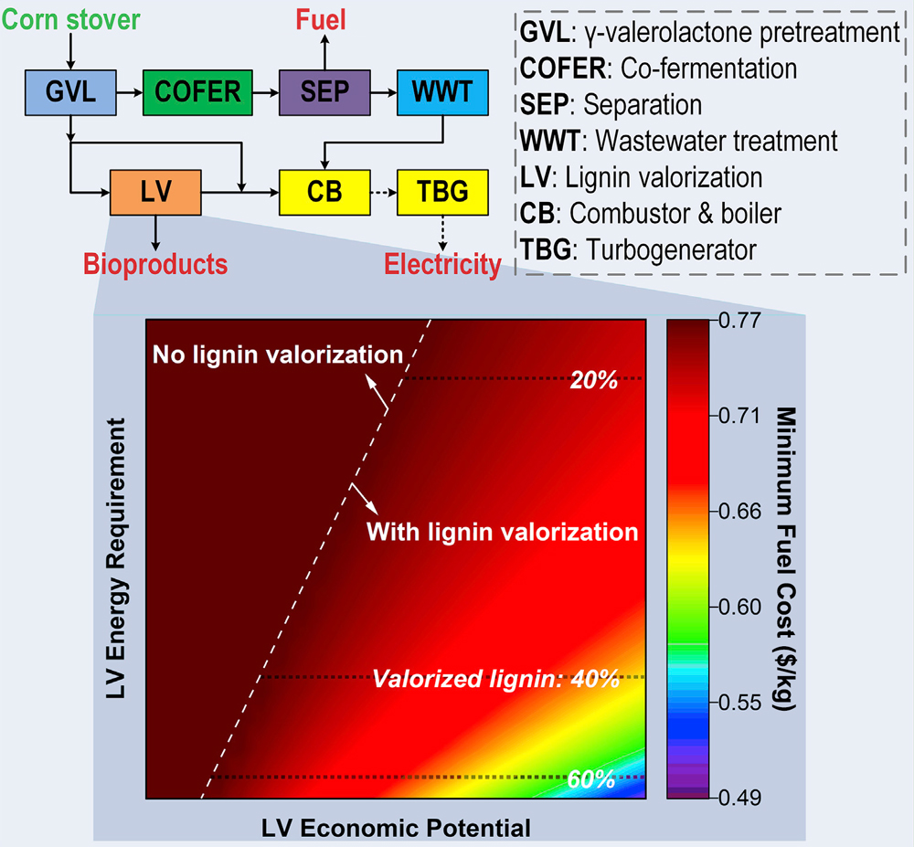
BRC Science Highlight
Optimizing biorefinery strategies for use with lignin valorization
Objective
To evaluate what technological advances are necessary for lignin valorization technologies to become economically attractive for lignocellulosic biorefineries.
Approach
Use a superstructure-based process synthesis to study different biorefinery configurations under different types of constraints.
Perform optimizations to evaluate impact of four critical parameters for lignin valorization: energy requirement of conversion and bioproduct recovery, conversion efficiency to bioproducts, production cost, and bioproduct selling price.
Further analyze how improvements in combinations of selected parameters can lead to lower cost for a thermal-neutral biorefinery.
Results/Impacts
The analysis establishes technology targets that must be met to make lignin valorization economically viable.
Selection of different pretreatment strategies may improve the economics under different constraints.
Minimum fuel cost as a function of profit and energy requirement for lignocellulosic biorefineries utilizing lignin valorization.
K. Huang, P. Fasahati, and C.T. Maravelias. “System-level analysis of lignin valorization in lignocellulosic biorefineries.” iScience (2020) 23, 100751 [DOI: 10.1016/j.isci.2019.100751]
GLBRC February 2020

