Slide 1
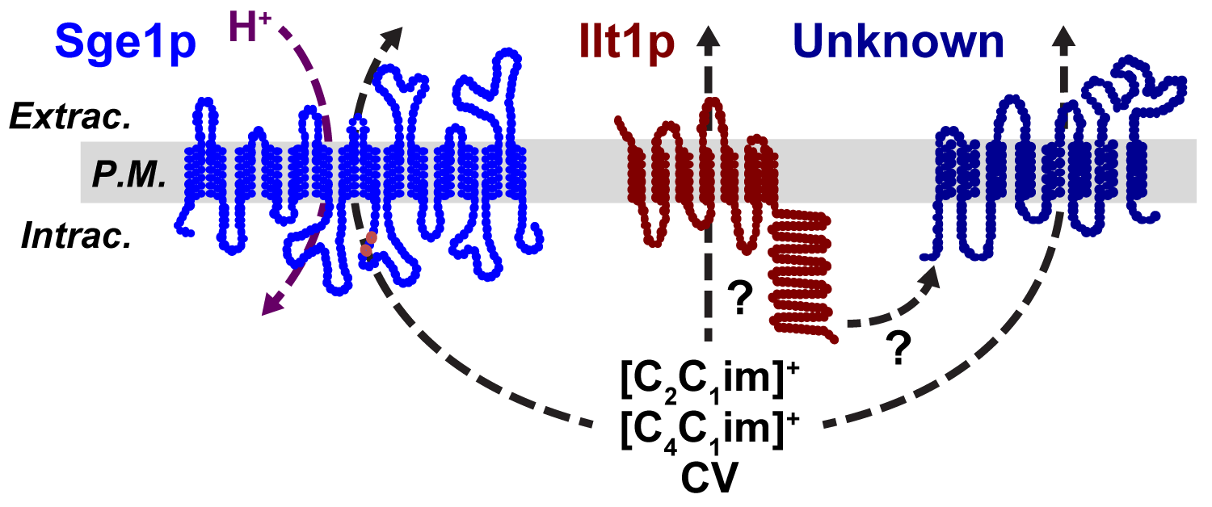
BRC Science Highlight
Natural genetic diversity of yeast aids in identification of genes involved in ionic liquid (IL) tolerance
Objective Exploit the natural genetic diversity of Saccharomyces cerevisiae isolates to identify genes that contribute to IL tolerance; elucidate defense mechanisms that cells employ to improve performance of bioconversion microbes.
Approach
ILs are deconstruction solvents that show great promise as a biomass pretreatment, but residual solvent can be toxic to microbes and inhibit biofuel production.
Examined over 100 S. cerevisiae yeast isolates from diverse ecological niches for growth in [C₂C₁im]Cl, identifying strains with exceptional tolerance to IL.
Screened DNA libraries from top performing strain to identify genes that contribute to IL resistance
Result/Impacts
Two genes were associated with increased IL tolerance: SGE1 and ILT1, encoding a multidrug efflux pump and a predicted membrane protein, respectively.
Two major sequence variants of the SGE1 gene were found to occur among yeast lineages that confer tolerance or sensitivity to IL; alterations in Sge1 protein stability and cell surface localization may impact the amount of IL that cells can pump out of the cell.
Natural variation among diverse microbial isolates is an important resource that can contribute to identification of biological mechanisms of interest for biofuels conversion.
Higgins, D.A. et al. 2018. Natural variation in the multidrug efflux pump SGE1 underlies ionic liquid tolerance in yeast. Genetics, DOI:10.1534/genetics.118.301161.
GLBRC August 2018
Notes:
Notes:
text
Title again:
Text 1-2 sentence summary?

