Slide 1
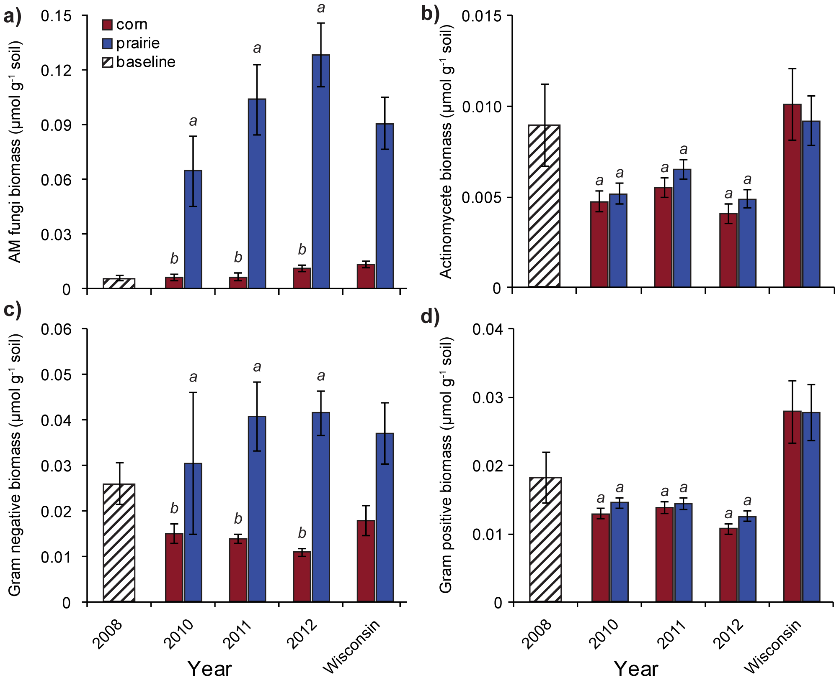
BRC Science Highlight
Plant-associated soil microbes respond rapidly to prairie establishment
Objective To understand the response of soil microbial communities to altered land use.
Approach
Used an existing cropping experiment to study how land use and land cover changes of prairie restoration affect the soil microbial community.
Tracked total microbial biomass, functional group biomass, and overall lipid composition in matched plots of continuous corn and prairie 2-4 years after the prairie’s establishment on formerly cropped land.
Absolute abundance of microbial functional group lipid biomarkers: (a) arbuscular mycorrhizal fungi; (b) actinomycetes; (c) Gram-negative bacteria; (d) Gram-positive bacteria in recently established corn and prairie biomass cropping systems and long-established, unmanaged baseline prairies. Baseline represents corn fields in the area; Wisconsin bars represent state-wide data.
Result/Impacts
Lipid biomarkers, which can be used as indicators of the dominant taxa in a microbial community, revealed differing composition between corn and prairie soil microbial communities soon after establishment.
Total biomass, arbuscular mycorrhizal fungi biomass, and Gram-negative bacteria biomass were significantly higher in restored prairie plots, approaching levels found in long-established, unmanaged plots.
These results indicate that the microbial community in agricultural soils can shift rapidly (within 2 years) after establishment in agricultural soils, and bounce back to levels similar to those of conservation prairies.
Herzberger, A.J. et. al. 2015. Bouncing Back: Plant-Associated Soil Microbes Respond Rapidly to Prairie Establishment. PLoS ONE, doi: 10.1371/journal.pone.0115775.

