Slide 1
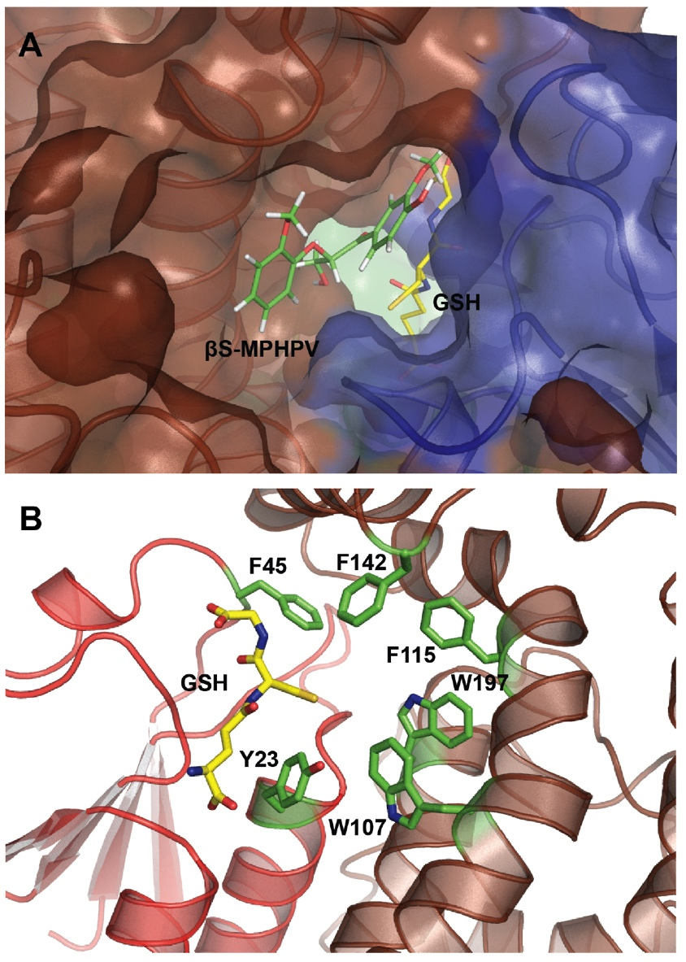
BRC Science Highlight
Structural Basis of Stereospecificity in Enzymatic Cleavage of Lignin Bonds
Objective To determine the structural basis for stereo-
specificity of bacterial enzymes involved in β-aryl ether bond cleavage of lignin
Approach Solve crystal structures and conduct corresponding biochemical analyses for LigE and LigF protein variants
Result/Impacts
LigE and LigF possess dramatically different structural arrangements within the monomers and different dimer interfaces; as a result, the substrate binding surfaces of these two enzymes are on opposite faces, hence introducing stereospecificity.
As lignin is the most abundant aromatic polymer in nature, this collaborative study¹ by GLBRC, JBEI, and others, combined with a second study,² informs broader lignin valorization efforts that will ultimately enable the development of efficient pathways for the conversion of lignin into renewable aromatics with applications in advanced biofuels and chemicals.
¹ Helmich KE, et al. 2016. Structural basis of stereospecificity in the bacterial enzymatic cleavage of b-aryl ether bonds in lignin. The Journal of Biological Chemistry, doi:10.1074/jbc.M115.69430.
² Pereira, JH, et al. 2016. Structural and biochemical characterization of the early and late enzymes in the lignin b-aryl ether cleavage pathway from Sphingobium sp SYK-6. The Journal of Biological Chemistry, doi:10.1074/jbc.M115.700427.
GLBRC March 2016
Notes:
Notes:
text
Title again:
Text 1-2 sentence summary?

