Slide 1
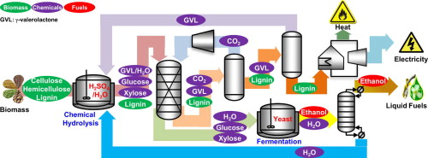
BRC Science Highlight
Process design and analysis of lignocellulosic biomass to biofuel using the renewable solvent γ-valerolactone (GVL)
Objective
Design a process for ethanol production from lignocellulosic biomass using GVL, evaluate the economic feasibility, and identify steps that may be targeted for improvement
Approach
Process uses the green solvent GVL and dilute acid to deconstruct lignocellulosic biomass without the use of expensive enzymes (e.g. cellulases)
Liquid extraction to generate aqueous sugar stream, which is fermented to ethanol by yeast
Downstream separation of GVL and lignin allows recycling of solvent and lignin utilization (e.g., burned for heat and electricity)
Evaluate technoeconomic parameters (process/energy efficiencies, capital and operating costs, minimum selling price, etc.) and compare to other ethanol production processes
Result/Impacts
The GVL process yields ethanol at a minimum selling price of $5 per gallon of gasoline equivalent, thus making it competitive with other current biofuel production strategies
GVL:biomass ratio is a key parameter; future efforts aim to lower this ratio for economic improvement
Han, J., Luterbacher, J.S., Alonso, D.M., Dumesic, J.A., Maravelias, C.T., 2015. A lignocellulosic ethanol strategy via nonenzymatic sugar production: process synthesis and analysis. BioresourceTechnology 182, 258-266.
GLBRC May 2015
Notes:
Notes:
text
Title again:
Text 1-2 sentence summary?

