Slide 1
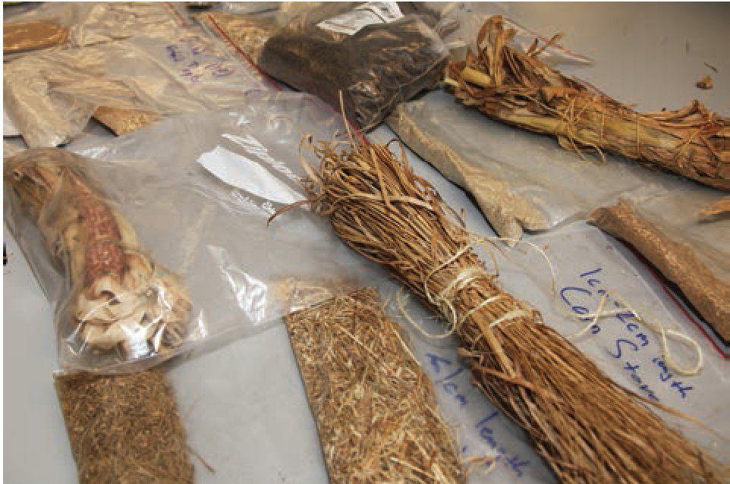
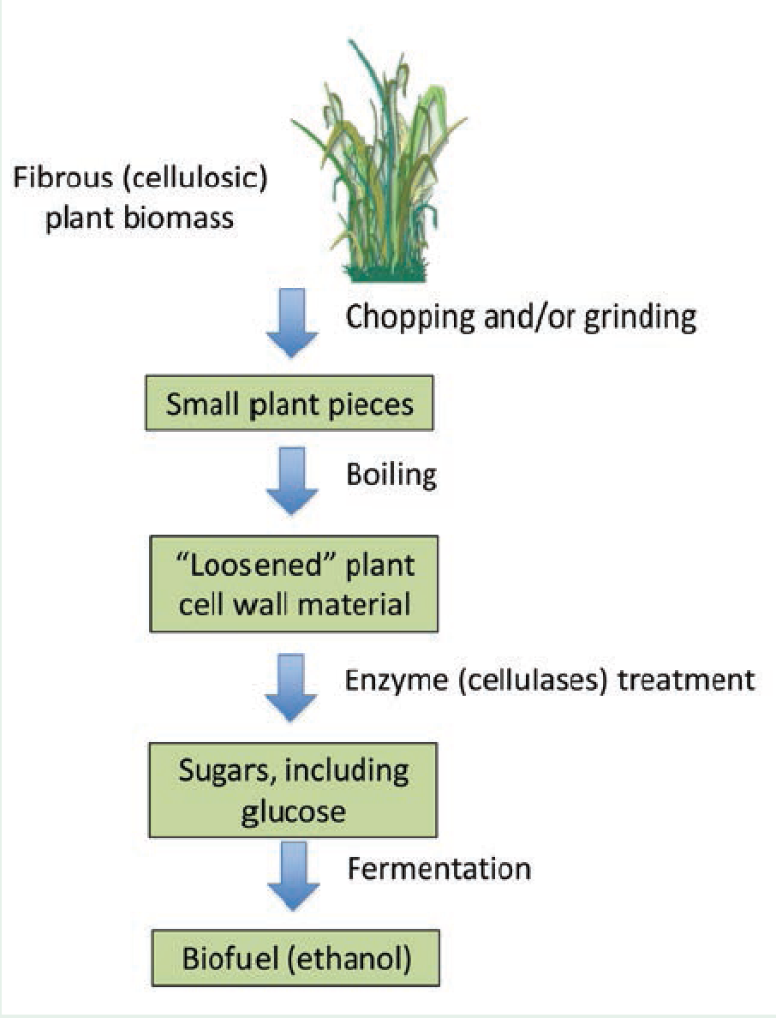
BRC Science Highlight
Facilitating Student Investigations into Making Liquid Fuel from Plant Biomass
Objective To bring biofuels to the high school and undergraduate science classroom by designing a flexible lab sequence that facilitates investigations into how different variables affect biomass-to-biofuel conversion.
Approach
Design protocol with readily available materials
Make the protocol flexible enough that it can be adapted to chemistry, environmental science, biology, engineering, and agriculture classrooms.
Align experiment with grades 9-12 Next Generation Science Standards
Result/Impacts
Teachers have a fully designed and debugged experiment
Students are able to experiment with different types of biomass, varying pretreatments, and manipulation of enzyme and fermentation conditions
Ties together current real-world issues, current scientific research, and classroom learning
Greenler J, Nye L, Tangen T (2014) Cellulose Breakdown. The Science Teacher September, 2014: 1-11
GLBRC January 2015
Notes:
Notes:
Transportation of goods accounts for 25% of global energy consumption; 95% of this transportation energy comes from petroleum
An alternate source of transportation energy is fibrous plant material (i.e. cellulosic biofuel)
This is an active area of research for laboratory scientists, engineers, agronomists, etc.
Many current investigations align with the Next Generation Science Standards
A laboratory protocol appropriate for highschool and undergraduate students, based on current investigations has been developed.
This protocol can be adapted to a wide range of courses – tying current real-world issues, current scientific research, and classroom leading together.
Facilitating Student Investigations into Making Liquid Fuel from Plant Biomass:
In September, GLBRC Education and Outreach leaders John Greenler and Leith Nye, in collaboration with Travis Tangen at the Wisconsin Alumni Research Foundation, published a laboratory protocol that facilitates student engagement in bioenergy research. This protocol, which is appropriate for high school chemistry, environmental science, biology, engineering, and agriculture classes, engages students in the inquiry process by experimenting with different types of biomass, varying pretreatments, and manipulating enzyme and fermentation conditions. The investigation, which aligns with the new national science standards, also works as an engineering challenge in which students define problems associated with efficiently converting cellulosic biomass to ethanol.

