Slide 1
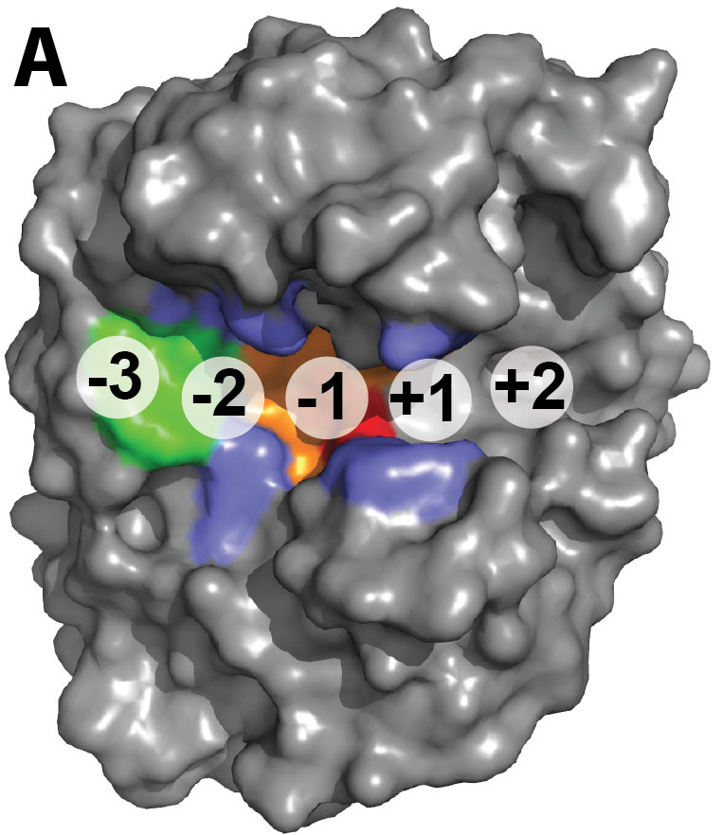
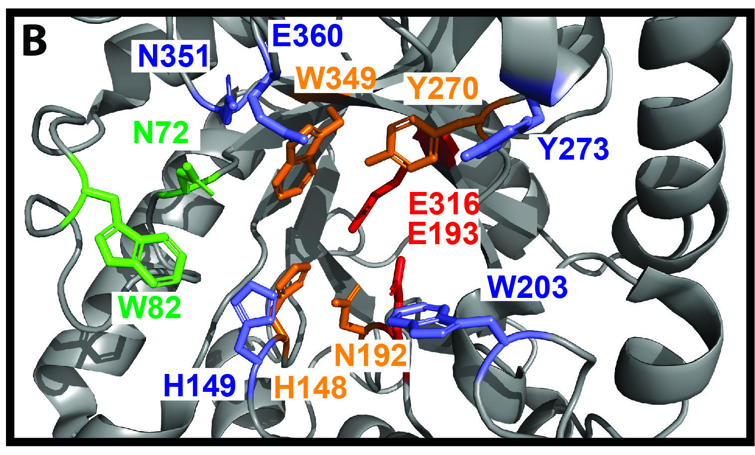
BRC Science Highlight
Structural features of substrate specificity
Objective Describe the functional diversity of members of a GH5 subfamily to explore the structural origins of their broad substrate specificity, a step toward engineering better enzymes for converting biomass into biofuels and other specialty bioproducts.
Approach
Express the catalytic domains of 243 GH5 members (238 in the GH5_4 subfamily) and quantify their activity against multiple polysaccharide substrates.
Conduct a phylogenetic analysis based on the measured enzymatic activity to identify three major GH5_4 clades with distinct activity patterns.
Use the structure of CelE to identify residues associated with broad enzymatic activity.
Results/Impacts
Activity against multiple polysaccharide substrates is relatively common among GH5_4 enzymes.
Two variably conserved residues in the binding cleft, H149 and W203, are linked to strong activity across all four substrates.
Enzyme sequences may be useful to predict and design enzyme activity against different types of biomass.
Active site residues. Residues related to substrate specificity in GH5_4 endoglucanases are (A) mapped onto the structure and (B) shown in the active site of CelE. Red, catalytic glutamates; orange, highly conserved in GH5; green, highly conserved in GH5_4; blue, variable residues within GH5_4.
Glasgow, EM. et al. “Extent and origins of functional diversity in a subfamily of glycoside hydrolases.” Journal of Molecular Biology online January 25 (2019) [DOI: 10.1016/j.jmb.2019.01.024].
GLBRC February 2019

