Slide 1
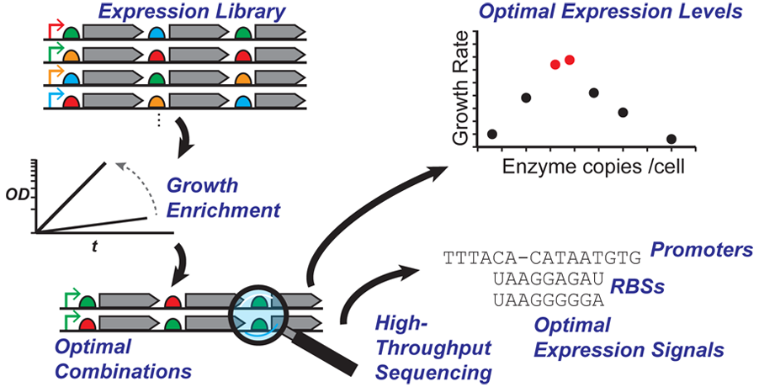
BRC Science Highlight
OptSSeq: High-Throughput Sequencing Readout of Growth Enrichment Defines Optimal Gene Expression Elements
Objective
Designing synthetic biofuel pathways with optimized and balanced enzyme levels can be challenging. Here we identified optimal gene expression elements for heterologous ethanol production from a combinatorial library of gene expression signals.
Approach
Generated libraries of promoter and ribosome binding site (RBS) variants representing pathway constructs spanning a range of gene strengths in different operon arrangements.
Expressed library variants in E. coli and used high throughput sequencing to track enrichment of gene expression signals within cell populations.
Result/Impacts
Cassettes with promoters driving strong but not maximal rates of transcription support the fastest ethanologenic growth.
Of two alcohol dehydrogenase genes tested, one was preferred for rapid growth.
OptSSeq is a general tool for synthetic biology to tune pathway enzyme levels whose function can be linked to cell growth or survival.
Ghosh, I. and Landick, R. OptSSeq: High-throughput sequencing readout of growth enrichment defines optimal gene expression elements for homoethanologenesis, ACS Synthetic Biology 5, 1519 (2016). DOI: 10.1021/acssynbio.6b00121.
GLBRC January 2017
Notes:
Notes:
text
Title again:
Text 1-2 sentence summary?

