Slide 1
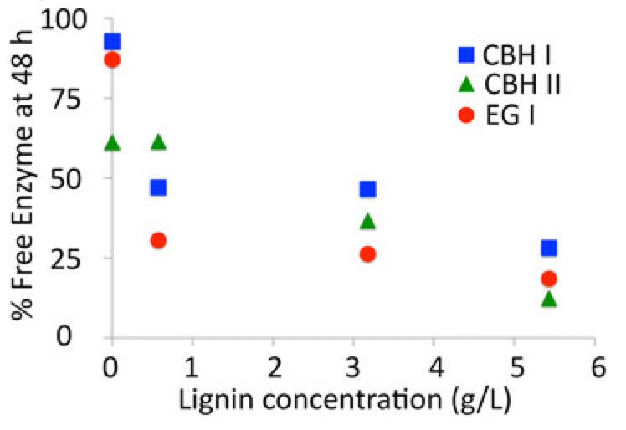
BRC Science Highlight
Effects of lignin on cellulase during lignocellulosic biomass saccharification
Objective To understand the binding of cellulase to pretreated lignocellulosic biomass during saccharification, which could result in the production of cheaper biofuels.
Approach
Quantified concentrations of various cellulases (CBH I, CBH II, and EG 1) in a complex hydrolysate mix via FPLC (fast protein liquid chromatography).
Biomass used was corn-stover (CS) pretreated via Ammonia Fiber Expansion (AFEX), Dilute Acid (DA), and Ionic Liquid (IL); which are the BRC pretreatment technologies.
Compared cellulase adsorption characteristics as a function of lignocellulose composition.
Figure - Free cellulase concentration in the hydrolysate supernatant as a function of total lignin concentration. Data for free CBH I, CBH II, and EG I after 48-h saccharification of Avicel (0 g/L lignin), IL-CS (0.58 g/L lignin), AFEX-CS (3.18 g/L lignin), and DA-CS (5.43 g/L lignin) at 50°C are reported here.
Result/Impacts
The relative fraction of bound individual cellulases varied depending on pretreatment, lignin abundance, and type of cellulase. DA-CS has highest levels of non-recoverable cellulases, while IL-CS, which has the minimal lignin content, had highest overall cellulase recovery.
By using recombinant family 1 CBM fusion proteins, it was shown that they are highly implicated in the non-productive binding of full-length T. reesei cellulases to lignin.
Recovery of cellulases would increase enzyme specific activity and facilitate enzyme recycling for better lignocellulosic biorefinery substrates.
Gao, D., Haarmeyer, C., Balan, V., Whitehead T.A., Dale, B.E., Chundawat, S.P.S. “Lignin triggers irreversible cellulase loss during pretreated lignocellulosic biomass saccharification”. Biotechnology for Biofuels(2014). 7:175
GLBRC May 2015
Notes:
Notes:
text
Title again:
Text 1-2 sentence summary?

