Slide 1
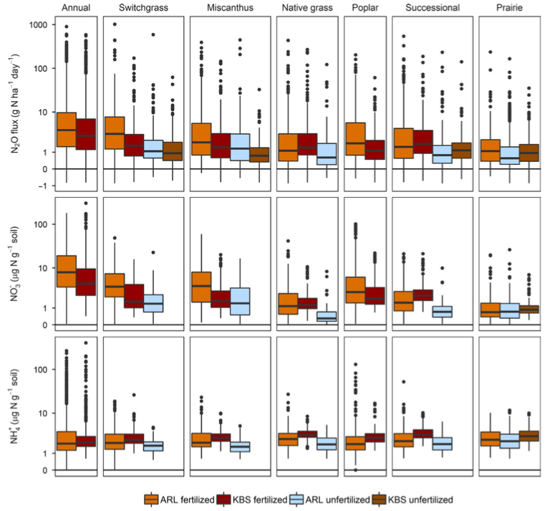
BRC Science Highlight
Environmental factors and their effect on soil nitrous oxide fluxes in bioenergy crops
Objective To understand the factors that influence soil N₂O production in bioenergy crops under field conditions.
Approach
Employed quantile regression to evaluate effects of soil temperature, water-filled pore space, and concentrations of soil nitrate and ammonium on the upper bounds of soil N₂O fluxes.
Collected data over six years from a range of bioenergy crops including no-till grain crops, perennial warm-season grasses, hybrid poplar, and polycultures of tallgrass prairie species each with and without N addition grown at two sites in the Midwest (MI, WI).
Result/Impacts
Framework suggests reducing concentration of NO₃⁻ in the soil may be effective at reducing “hot moments” of N₂O production.
Reduction may be accomplished using enhanced efficiency fertilizers which promote a gradual release of NO₃⁻ over time; and by increasing the diversity and perenniality of crops which reduces the amount of available N in the soil.
Duncan, D. et al. “Environmental factors function as constraints on soil nitrous oxide fluxes in bioenergy feedstock cropping systems”. GBC Bioenergy. DOI: 10.1111/gcbb.12572
GLBRC February 2019

