Slide 1
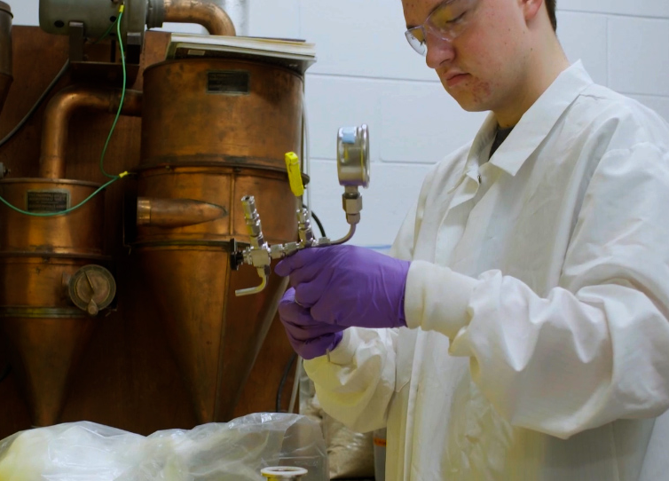
BRC Science Highlight
Breaking down bioenergy crops
Objective Develop a standard operating procedure for the ammonia fiber expansion (AFEX) pretreatment, a method that produces highly digestible plant biomass that can be used directly as animal feed or as a feedstock to generate biofuels and bioproducts.
Approach
Describe lab-scale AFEX procedure to produce pretreated biomass available for hydrolysis and fermentation into biofuels and bioproducts.
Click picture above for video of the step-by-step procedure for laboratory-scale AFEX pretreatment of plant-derived feedstocks. Also available here: go.wisc.edu/afex-video
Result/Impacts
AFEX pretreatment breaks down large carbohydrates in feedstocks increasing the yield of biofuels and bioproducts.
Detailed standard operating procedure for AFEX pretreatment can be applied to biomass in any laboratory that has required laboratory materials and proper ventilation.
Results of lab-scale AFEX pretreatment for testing biomass at high throughput are representative of large-scale AFEX pretreatment results.
Chundawat, S.P.S. et al. “Ammonia Fiber Expansion (AFEX) Pretreatment of Lignocellulosic Biomass.” Journal of Visualized Experiments 158, e57488 (2020). [DOI: 10.3791/57488]
GLBRC July 2020
Notes:
Notes:
text
Title again:
Text 1-2 sentence summary?

