Slide 1
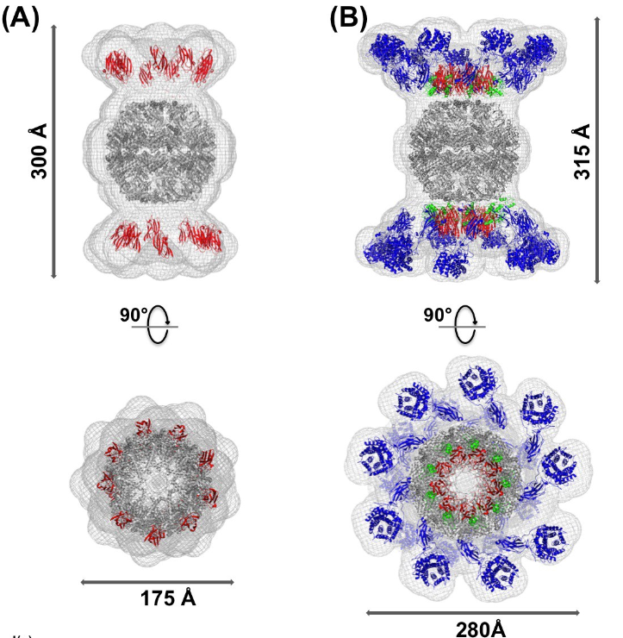
BRC Science Highlight
Saccharification of thermochemically pretreated cellulosic biomass using native and engineered cellulosomal enzymes
Objective To study the role of enzyme complexation on the deconstruction of pretreated biomass
Approach
Collaboration between GLBRC, BESC, and other institutions.
C. thermocellum is a bacterium that deconstructs biomass using large multi-enzyme complexes called cellulosomes.
Compared the activity of the most abundant cellulosomal enzymes from C. thermocellum and investigated the importance of enzyme complexation using an engineered protein scaffold (called ‘rosettasome’).
Tested the performance of free enzymes, enzyme-rosettasome (or rosettazyme) complexes, and cellulosomes on distinct forms of cellulose formed during biomass pretreatment.
Result/Impacts
The scaffold-immobilized enzymes always gave higher activity than the free enzymes, but cellulosomes exhibited higher activity than rosettazyme complexes.
SAXS predicted molecular structure of the rosettasome– cohesin scaffold (A) and rosettazyme (B) superimposed on known atomic structures. The SAXS mesh (light grey) surrounds the ribbon representation of the rosettasome double rings (dark grey), cohesins (red), dockerins (green), and cellulases (blue) prepared using Pymol.
Scaffold-tethered enzymes gave lower saccharification yields on industrially relevant lignin-rich switchgrass than cellulose alone, as well as comparable activity on all forms of cellulose tested.
Type of pretreatment can significantly impact the saccharification efficiency of cellulosomal enzymes for various bioprocessing scenarios, and pretreatments that remove both lignin and hemicellulose can help improve the specific activity of cellulosomal enzymes.
Chundawat, S. P. S., et al. (2016). "Saccharification of thermochemically pretreated cellulosic biomass using native and engineered cellulosomal enzyme systems." Reaction Chemistry & Engineering 1(6): 616-628 [DOI: 10.1039/C6RE00172F]
GLBRC May 2017
Notes:
Notes:
text
Title again:
Text 1-2 sentence summary?

