Slide 1
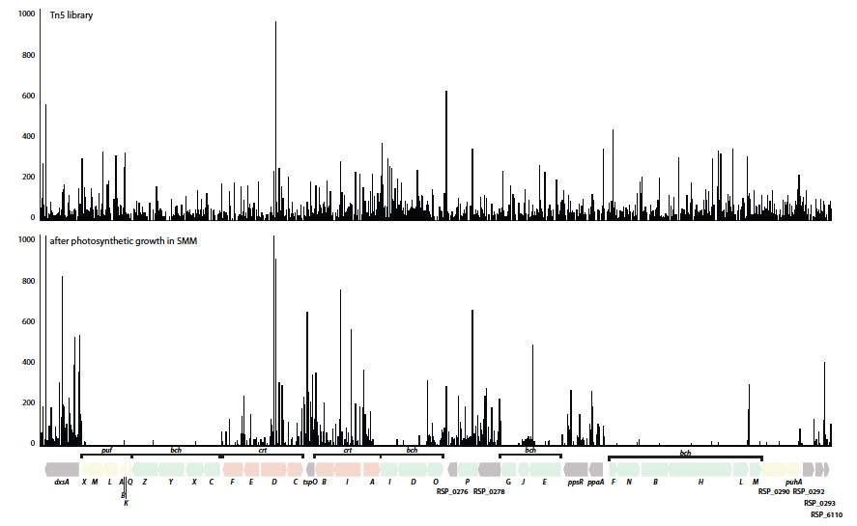
BRC Science Highlight
Combining genome-scale experimental and computational methods to identify essential genes in bacteria
Objective Implement a new software analysis tool (TSAS) to identify the contributions of genes in a Rhodobacter sphaeroides Tn-seq mutant library.
Approach
Used a random Tn5 mutant library to identify essential genes under a range of conditions, based on the frequency of insertions across the genome.
TSAS-derived predictions were able to improve the predictions of a genome-scale metabolic model of this bacterium.
Genome browser view of the photosynthetic gene cluster of R. sphaeroides showing frequency of random Tn5 insertions in cells grown under control (top panel) or photosynthetic (bottom panel) growth conditions. Most genes colored in yellow or green are essential, with a very low tolerance for Tn5 insertions. In contrast, Tn5 insertions in a majority of the genes colored pink are tolerated, indicating that these genes are dispensable for photosynthetic growth.
Result/Impacts
TSAS made accurate predictions of the essentiality of many known genes and identified genes not previously considered to be essential.
Shows how combining genome-scale experimental and computational methods can provide insight into enzymes and pathways involved in synthesis of biofuel and biochemicals.
Burger, BT et al. 2017. Combining genome-scale experimental and computational methods to identify essential genes in Rhodobacter sphaeroides. mSystems, DOI:10.1128/mSystems.00015-17.
GLBRC June 2017
Notes:
Notes:
text
Title again:
Text 1-2 sentence summary?

