Slide 1
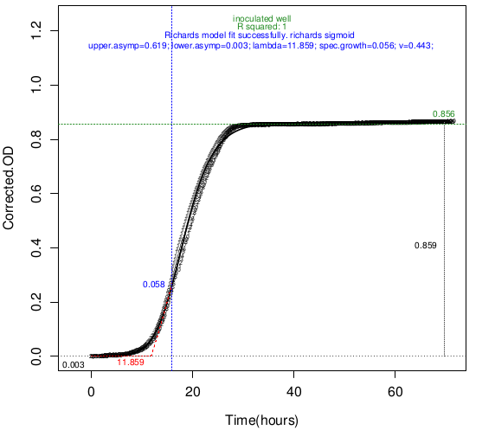
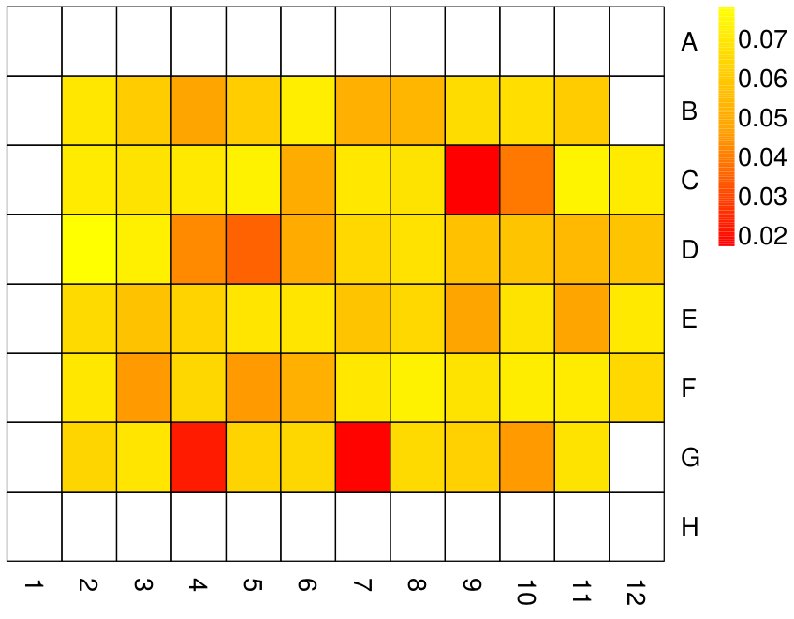
BRC Science Highlight
Modeling Microbial Growth Curves With GCAT
Objective To provide researchers with a convenient tool to analyze high-throughput, microtiter plate-based microbial growth data efficiently.
Approach
GCAT analyzes dozens to hundreds of growth curves at once
GCAT can fit a global sigmoid model or local regression (LOESS), according to user preferences. The global sigmoid mode automatically selects the statistical best fit of 3 different formulas
GCAT computes essential growth curve properties, such as amplitude, maximal specific growth rate and lag time
User interacts with GCAT through a web browser
A typical sigmoid growth curve
Result/Impacts
GCAT enables researchers to efficiently analyze growth curve data from screens involving dozens to hundreds of strains or growth conditions. These screens can have multiple applications, such as identification of strains that are best adapted to growth on bioenergy media
A GCAT server is publicly available at http://gcat-pub.glbrc.org/
A plate overview heat map showing maximal specific growth rates of a collection of yeast strains
Bukhman Y. V. et. al. 2015. Modeling Microbial Growth Curves With GCAT. Bioenergy Research, doi:10.1007/s12155-015-9584-3.
GLBRC March 2015
Notes:
Notes:
text
Title again:
Text 1-2 sentence summary?

