Slide 1
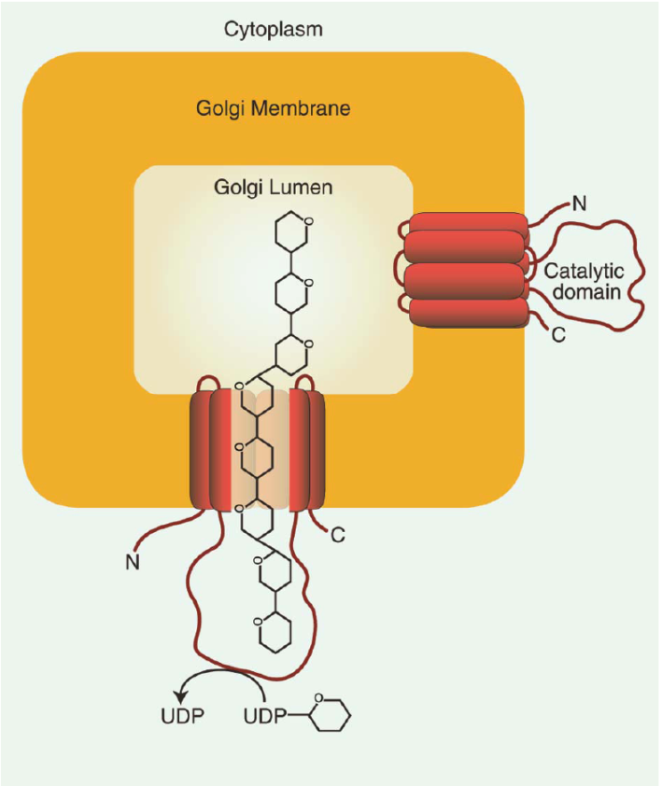
BRC Science Highlight
Mixed-Linked Glucan Synthesis Explorations Refine Biosynthetic Model
Objective Understanding the biosynthesis of mixed-linked glucan (MLG), a major carbon source for grass-based biofuel production, by establishing the topology of the BdCSLF6 enzyme.
Approach
Generated fluorescent (YFP) or T7 tagged Brachypodium CSLF6 (BdCSLF6); expressed in tobacco and yeast
Co-expression of YFP tagged BdCSLF6 and Golgi marker used to identify localization of BdCSLF6
Immuno-gold labeling and ELISA used to determine protein functionality and specificity
Proteinase K and Factor Xa analyses used to determine topology
Result/Impacts
Results support: BdCSLF6 localization in the Golgi; gene fusion functionality; ability to synthesize MLG in the Golgi; localization of C and N-termini as well as catalytic domain in cytoplasm; and enzyme functionality in non-plant systems
Supports a model where (1) BdCSLF6 alone can synthesize MLG using UDP-glucose in the cytoplasm, (2) MLG is channeled through the biosynthetic membranes of the Golgi and (3) secreted into the cell wall through the default pathway
While the evidence supports proposal of model for steps of MLG biosynthesis, results do not preclude possibility of other isoforms expressed in other cellular locations
Kim S-J, Zemelis S, Keegstra K, Brandizzi F (2015) The cytoplasmic localization of the catalytic site of CSLF6 supports a channeling model for the biosynthesis of mixed-linkage glucan. The Plant Journal Accepted Article: doi: 10.1111/tpj.12748
GLBRC January 2015
Notes:
Mixed-Linked Glucan Synthesis Explorations Refine Biosynthetic Model
Up to 20% of the cell wall in grasses is composed of mixed-linked glucan (MLG). The MLG carbohydrate is an important plant-based energy source for human consumption and potentially a readily accessible carbon source for biofuel production. MLG synthesis depends on two cellulose-synthase-like gene families (CSLH & CSLF). Although, importance of CSLF family in the grasses during MLG synthesis has been reported, relatively little is known about how and where CSLF proteins produce MLG in the cell. GLBRC Researchers investigated the topology of CSLF6 by expressing a CSLF gene found in the model grass Brachypodium (BdCSLF6) in both tobacco epidermal cells and the yeast Pichia. Using a combination of live cell imaging, immuno-electron microscopy, and protease protection assays, the catalytic domain BdCSLF6 was mapped in the cytoplasmic face of Golgi membranes and it was demonstrated that a Golgi localization is sufficient for MLG biosynthesis. In addition, researchers determined that the BdCSLF56 protein is capable of producing both chemical linkages found in the glucan chain of MLG. The evidence acquired in this study enables the proposal of a model for the steps in MLG biosynthesis: BdCSLF6 uses the cytosolic pool of UDP-glucose to synthesize and extend the MLG chain towards the lumen of the Golgi for secretion. Once incorporated in the cell wall, the MLG is a readily available source of carbon for biofuels production. Understanding the biosynthetic processes associated with MLG synthesis make it easier to exploit this carbohydrate for biofuel production. Future analyses are likely to offer important insights into the complex machinery that enable the biosynthesis of other important cell wall components.

