Slide 1
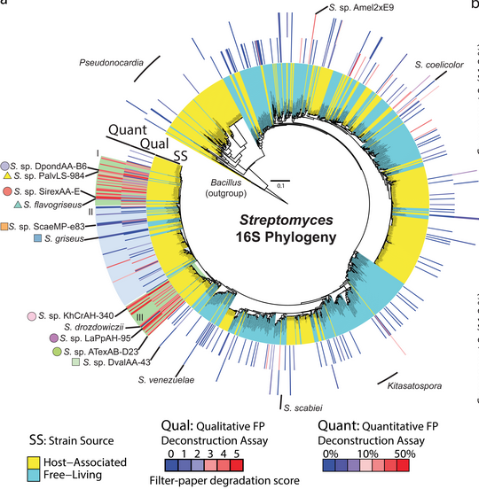
BRC Science Highlight
Evolution of cellulolytic activity in Streptomyces
Objective
To understand the processes driving the evolution of biomass deconstruction in the Streptomyces genus.
Approach
Compared the phylogenetic diversity of over 1,100 strains of Streptomyces and used a quantitative filter paper (FP) assay to measure the cellulose degrading activity of 223 diverse strains isolated from free-living and eukaryotic host-associated niches.
13% of the strains (29/223) deconstructed cellulose with activity comparable to Streptomyces sp. Sirex-AA from wood wasps, and 86% of the highly cellulolytic organisms grouped into 2 phylogenetically distinct clades associated with insects that feed on plant biomass (red lines, clades I and III – see Figure 1).
Figure 1. Distribution of cellulolytic ability in the genus Streptomyces.
Result/Impacts
Plant biomass degrading enzymes (CAZy) are widespread in Streptomyces, but the ability to rapidly deconstruct cellulose is surprisingly rare in this genus (and enriched in strains associated with insect hosts that feed on plant biomass).
Genomic, transcriptomic, and biochemical analyses identified key changes in gene content and transcriptional control of expression that confer highest cellulolytic activity.
Genes from naturally evolved cellulolytic Streptomyces are a rich new resource for biotechnology research.
Book AJ, Lewin GR, McDonald BR, Takasuka TE, Wendt-Pienkowski E, Doering DT, Suh S, Raffa KF, Fox BG, Currie CR “Evolution of High Cellulolytic Activity in Symbiotic Streptomyces through Selection of Expanded Gene Content and Coordinated Gene Expression”. PLOS Biology. 55 (12), 14(6): e1002475 (2016) [DOI: 10.1371/journal.pbio.1002475]
GLBRC February 2017
Notes:
Notes:
text
Title again:
Text 1-2 sentence summary?

