Slide 1
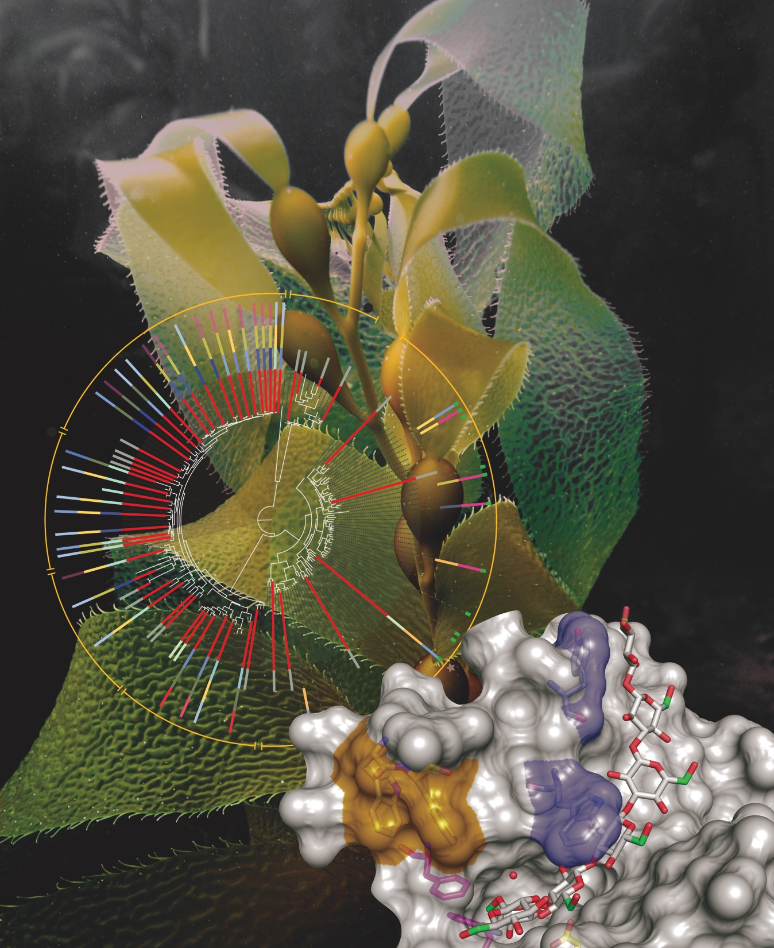
BRC Science Highlight
Active site and laminarin hydrolysis in glycoside hydrolase family 55 (GH55)
Objective Determine the structure, mechanism and breadth of natural reactivity in the GH55 enzyme family
Approach
Collaboration of GLBRC and JGI; X-ray diffraction data collected at DOE Argonne National Laboratory
High resolution crystal structures with substrates bound and ensemble refinement suggest a simple new mechanism for promoting processive reactivity
Active site architecture defines an exo-glucanase mechanism and gives high tolerance for branching found in natural β-1,3-glucans such as kelp laminarin
Result/Impacts
Gene synthesis and automated protein translation assigned function to 20% of the GH55 family; this is a new way to annotate bioenergy phylogenetic space
Broad range of properties including optima for pH, temperature and rates identified in natural enzymes
Best enzymes are highly efficient in hydrolyzing laminarin (found in kelp, a potential bioenergy crop) into simple sugars
Bianchetti CM, Takasuka TE, Deutsch S, Udell HS, Yik EJ, Bergeman LF, Fox BG. “Active Site and Laminarin Binding in Glycoside Hydrolase Family 55”. Journal of Biological Chemistry (2015). 290 (19):11819.
GLBRC April 2015
Notes:
Notes:
text
Title again:
Text 1-2 sentence summary?

