Slide 1

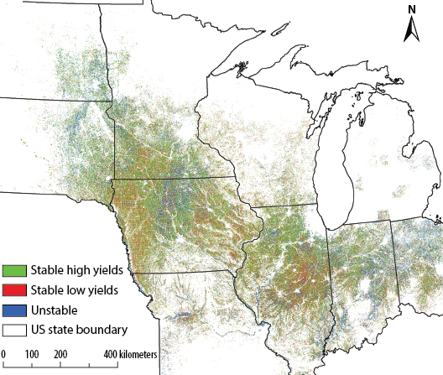
BRC Science Highlight
Yield stability analysis reveals sources of large-scale nitrogen loss from the US Midwest
Objective Classify croplands across the Midwest depending on yield and estimate the amount of nitrogen (N) loss in areas of low or unstable yield due to over-fertilization.
Approach
Using eight years of satellite imagery, field boundaries, and crop data, classify areas as high, variable, or low yield.
Estimate amount of N fertilizer used and lost in each of field type to determine the impacts on farmers’ bottom line, greenhouse gas (GHG) emissions, and nitrogen runoff into water systems.
Result/Impacts
46% of land farmed for corn and soybean was high-yielding, 26% consisted of stable low yielding, and 28% unstable.
Low-yielding areas contributed to 44% of total N loss, with another 31% lost from unstable areas. Over-fertilization in low and variable yielding areas poses a total loss of approximately $485 million in fertilizer value to farmers, corresponding to GHG emissions estimated at 6.8 MMT CO₂ equivalents.
N fertilizer recommendations based on yield stability class could thus provide substantial savings.
B. Basso, et al., “Yield stability analysis reveals sources of large-scale nitrogen loss from the US Midwest.” Nature Scientific Reports 10, 5774 (2019). DOI:10.1038/ s41598-019-42271-1.
GLBRC June 2019
Notes:
Notes:
text
Title again:
Text 1-2 sentence summary?

