Slide 1
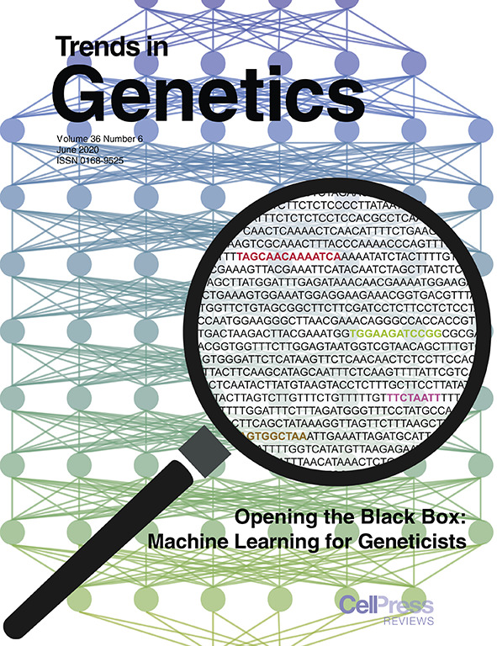
BRC Science Highlight
Machine learning models guide genetics research
Objective Highlight the importance of, and progress in, interpretable machine learning models in genetic and genomics research.
Approach
Apply strategies for interpretation of machine learning models to understand why and how the models works.
Findings from machine learning models provide hypotheses that can be tested in the field and lab.
Result/Impacts
Machine learning can integrate large heterogenous datasets into interpretable models that provide solutions to existing problems.
Large genetics and genomics datasets can be analyzed for patterns to answer new and challenging questions.
The article was featured on the cover of the June issue of Trends in Genetics
GLBRC researchers are applying machine learning to switchgrass genetic studies to identify morphological or biochemical traits that will improve biofuel production.
C.B. Azodi, et al., “Opening the Black Box: Interpretable Machine Learning for Geneticists.” Trends in Genetics 36, 442-455 (2020). [DOI:10.1016/j.tig.2020.03.005]
GLBRC June 2020
Notes:
Notes:
text
Title again:
Text 1-2 sentence summary?

