Slide 1
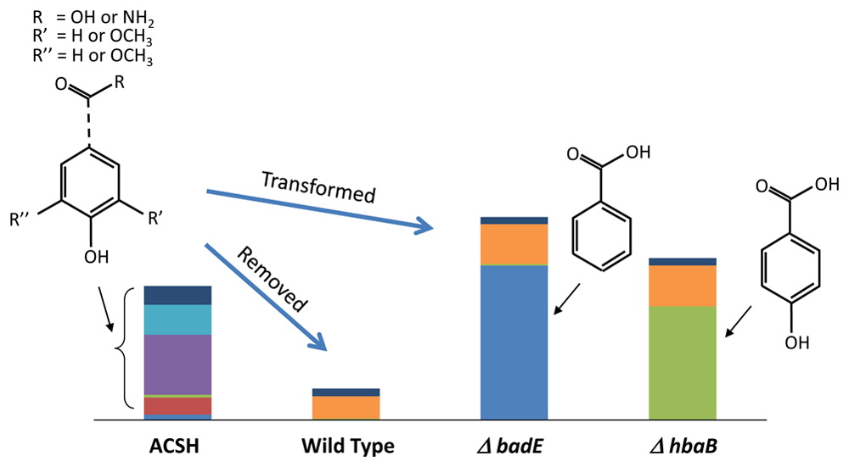
BRC Science Highlight
Metabolism of multiple aromatic compounds in corn stover hydrolysate by Rhodopseudomonas palustris
Objective Many aromatic compounds are toxic to biofuel microbes. The goal of this study was to determine the potential for removal or bioconversion of aromatic compounds from lignocellulosic hydrolysate using the purple non-sulfur bacterium Rhodopseudomonas palustris.
Approach
Monitor chemical composition of corn stover hydrolysate, before and after growth of R. palustris to determine the fate of sugars and inhibitory compounds, particularly aromatics.
Determine the metabolic pathway(s) for R. palustris aromatic removal.
Ask whether removal of aromatics could improve growth of a microbe that is sensitive to untreated hydrolysate.
Result/Impacts
R. palustris can remove most of the aromatic compounds from corn stover hydrolysate, leaving the sugars intact, and yielding a “scrubbed” hydrolysate that is easily fermented.
Most of the aromatic substrates are metabolized by the benzoyl-CoA pathway.
Use of R. palustris mutants in the benzoyl-CoA pathway allows for enrichment of aromatic intermediates that may be recoverable as an additional bioproduct.
Austin, S. et al. 2015. Metabolism of multiple aromatic compounds in corn stover hydrolysate by Rhodopseudomonas palustris. Environmental Science and Technology, DOI: 10.1021/acs.est.5b02062.
GLBRC July 2015
Notes:
Notes:
text
Title again:
Text 1-2 sentence summary?

