Slide 1
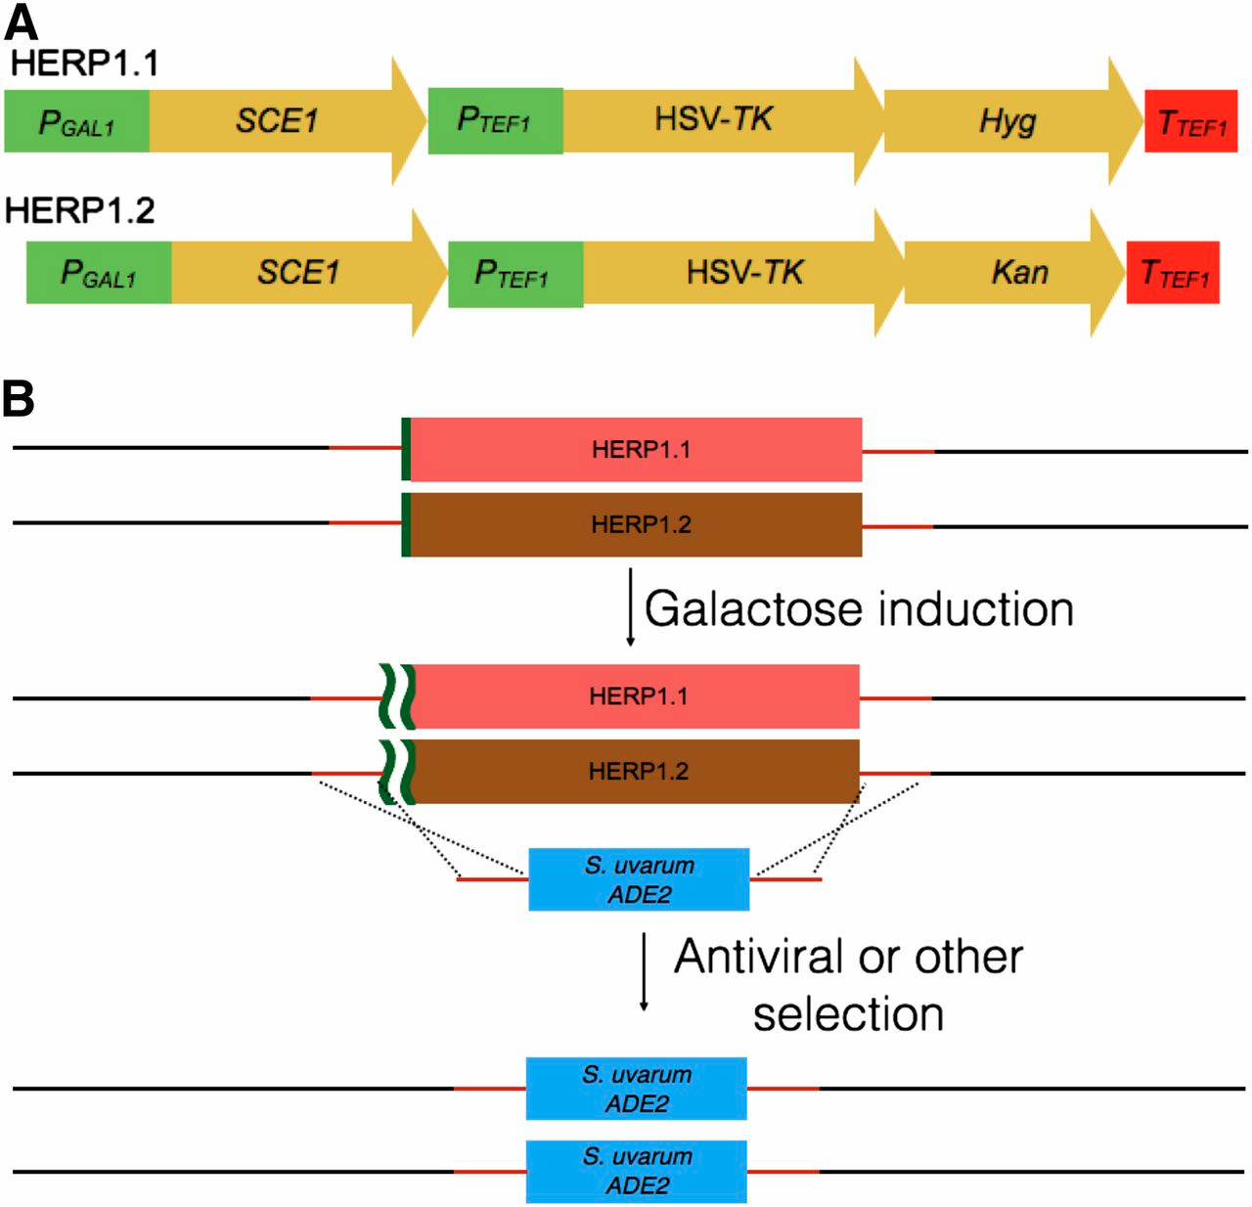
BRC Science Highlight
A New Genome Editing Tool for Use in a Variety of Saccharomyces Species
Objective To broaden the scope of genetic tools available for genome modification in both laboratory and natural yeast isolates. The developed system is referred to as Haploid Engineering and Replacement Protocol (HERP).
Approach
Designed a gene replacement cassette that incorporates viral thymidine kinase (TK) as a selectable marker plus an inducible. endonuclease to promote recombination (SCE1).
Measured efficiency of gene replacement in S. cerevisiae and related species.
Result/Impacts
The HERP system enables gene replacement at ~1% efficiency and is applicable to high-throughput transformation and screening of strains.
Gene modification works in a variety of Saccharomyces species; enables efficient replacement of both chromosomal alleles in diploid strains, broadening its use in natural isolates and non-traditional yeasts.
Alexander WG, Doering DT, Hittinger CT (2014) High-efficiency genome editing and allele replacement in prototrophic and wild strains of Saccharomyces. Genetics 198: 859-866.
GLBRC February 2015
Notes:
Notes:
text
Title again:
Text 1-2 sentence summary?

