Slide 1
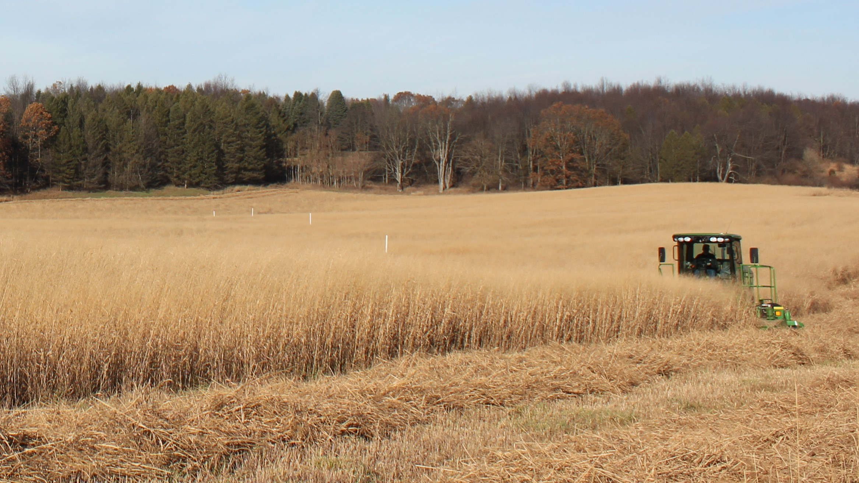
BRC Science Highlight
Ecosystem carbon balances on CRP grassland conversion to cropping systems
Objective
To assess the long term dynamics of carbon exchange upon conversion of USDA Conservation Reserve Program (CRP) grassland and existing cropland to alternative bioenergy crops.
Approach
Followed for 8 years the net ecosystem exchange of CO₂ on conversion of CRP and crop lands to switchgrass, restored prairie, and continuous corn.
Bioenergy feedstocks at the Kellogg Biological Station
Results
Converted CRP lands emitted to the atmosphere a large amount of soil carbon that had accumulated during the CRP years, though less from perennial crops; rates of exchange suggest that emissions will likely persist for ~14 years.
Converted cropland to the same crops resulted in immediate carbon storage by the perennial crops owing to the replenishment of low soil carbon levels; the corn system neither lost nor gained soil carbon.
Growing perennial crops for biofuel on marginal croplands with depleted soil carbon will result in immediate carbon storage, whereas growing crops on land with large existing carbon stores will take years for sequestration to re-establish.
Abraha, M. et al. “Ecosystem carbon exchange on conversion of Conservation Reserve Program grasslands to annual and perennial cropping systems” Agricultural and Forest Meteorology DOI:10.1016/j.agrformet.2018.02.016
GLBRC August 2018

