Slide 1
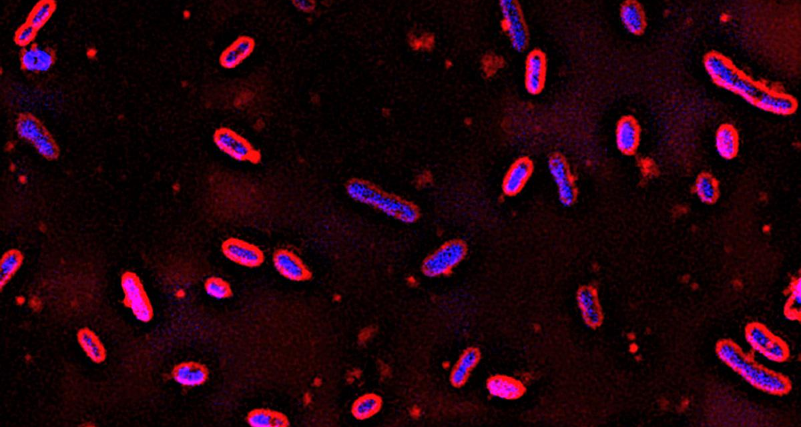
Novosphingobium aromaticivorans produces plastic precursors from lignin biomass
BRC logo here
Background/Objective
Muconic acid is a platform chemical that can be easily converted into monomers used in the production of plastics and a metabolic intermediate in the β-ketoadipic acid pathway of many bacteria. This work demonstrates that engineered strains of Novosphingobium aromaticivorans can produce cis,cis-muconic acid (ccMA) from lignin biomass.
Approach
Scientists confirmed the activity of two previously uncharacterized enzymes required to convert aromatic intermediates to ccMA and engineered one strain using native genes and another using genes previously used in microbial synthesis of the compound.
Novosphingobium aromaticivorans, a soil bacteria with an appetite for hydrocarbons, can be engineered to produce a chemical building block for plastics from underutilized plant biomass.
Results
Both strains produced greater than 100% yield of ccMA from aromatic monomers in liquor derived from alkaline pretreated biomass.
Significance/Impacts
Plant biomass is an underutilized and abundant renewable resource for the production of valuable chemicals, but many deconstruction methods generate a heterogeneous mixture of aromatics that make it difficult to extract these chemicals with current methods. This study reports on new features of N. aromaticivorans that can be used to produce ccMA from biomass aromatics.
Vilbert, Avery C. et al. Engineering Novosphingobium aromaticivorans to produce cis,cis-muconic acid from biomass aromatics. Applied and Environmental Microbiology 0, e01660-23 (2023). [DOI:10.1128/aem.01660-23]

