Slide 1
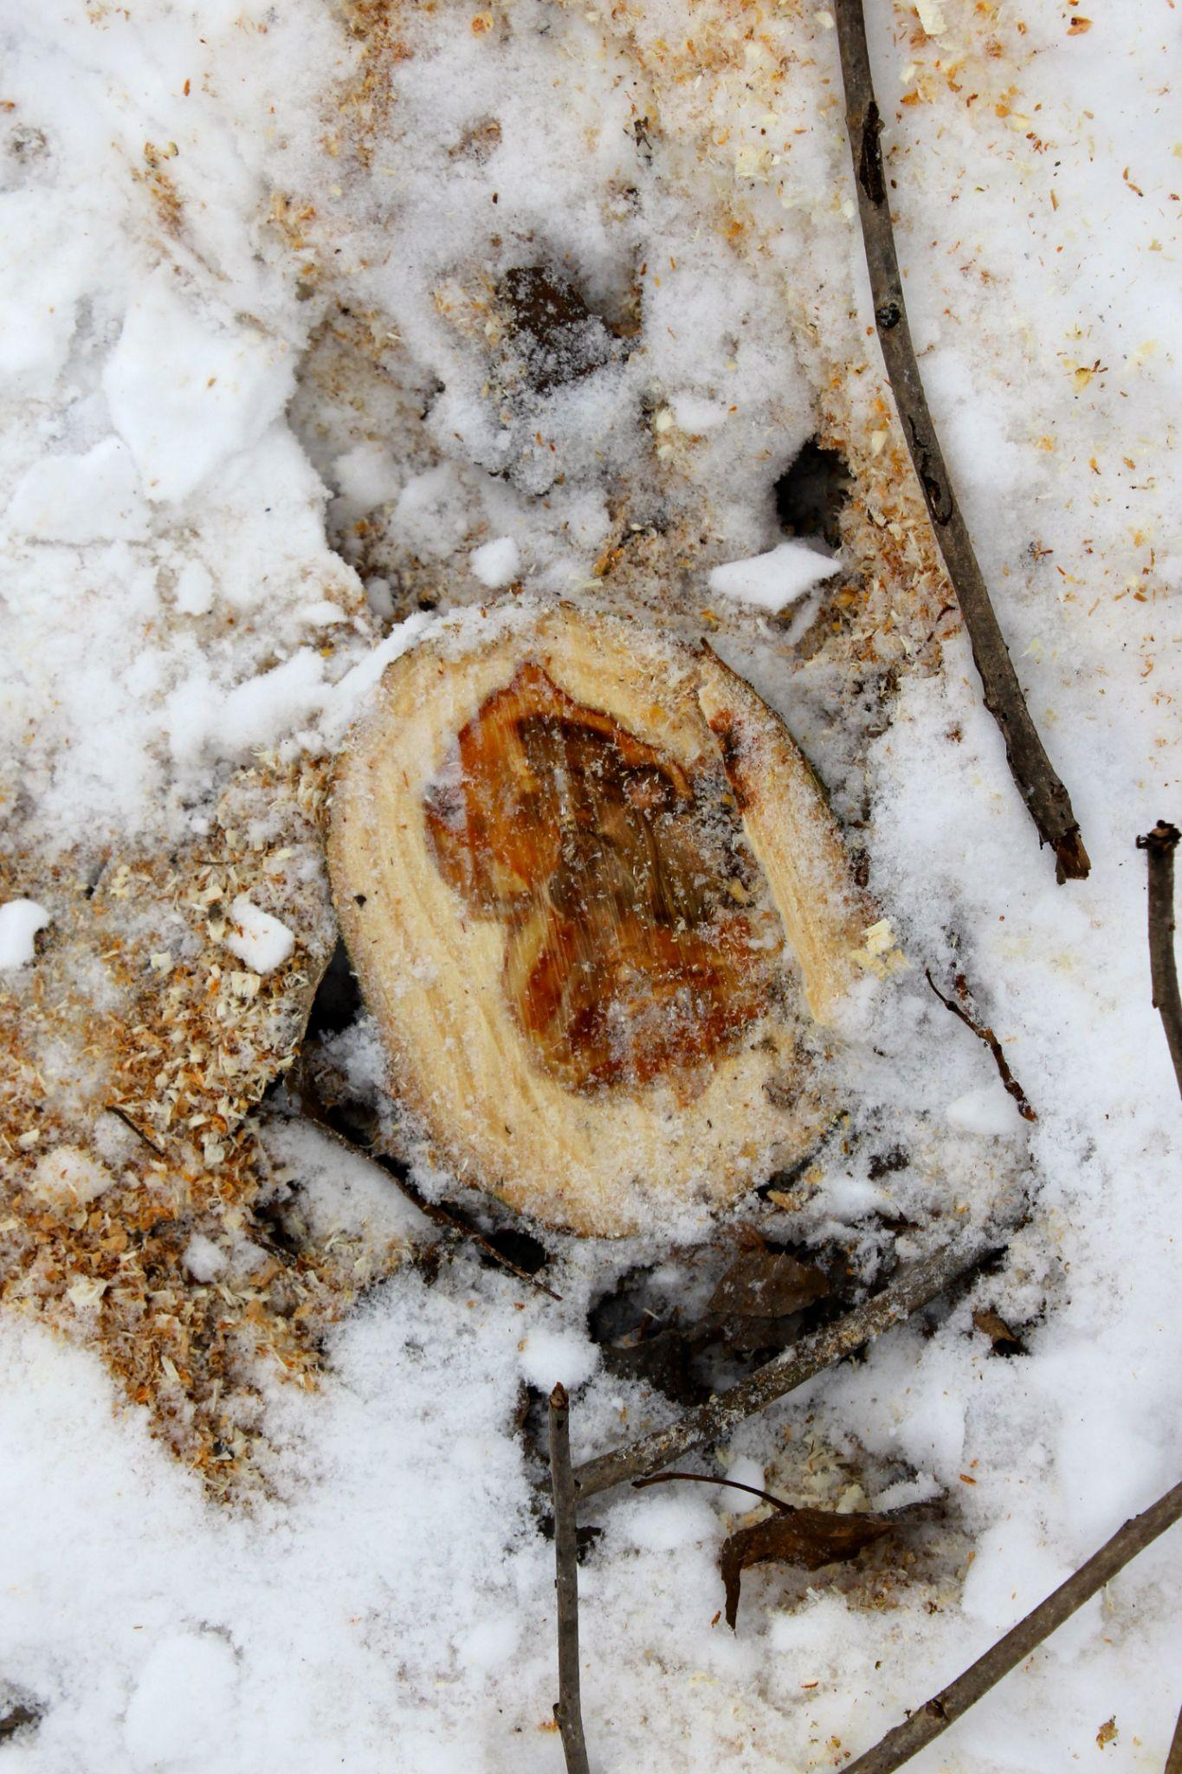
Rice gene opens up fresh lignin lead
Background/Objective
Previous research demonstrated that the Angelica sinensis gene AsFMT improves the processing efficiency of lignin in poplar trees as compared to wild-type trees. To this end, scientists with the Great Lakes Bioenergy Research Center introduced the more efficient rice gene OsFMT1 and compared the results to wild-type poplars and existing AsFMT poplar trees.
Approach
The rice gene introduces monolignol ferulate ester conjugates into the lignin polymers and reduces the energy and/or chemical loading needed to break down the polymers into smaller fragments. To quantify the effect of the OsFMT1 gene, researchers used UV-vis spectroscopy to screen for ester linkages, NMR to confirm the chemical nature of the lignin, and the DFRC method to determine how the ferulate groups were linked.
Results
The engineered poplars demonstrated a higher saccharification efficiency than the wild-type poplars. Under the same pretreatment conditions, the researchers observed a greater monosaccharide release from the modified lignin. In addition, the trees produced high-value phenolics that are easily accessible to support other specialty chemical industries.
A stump from a harvested poplar planted on a GLBRC biofuels site.
Significance/Impacts
Improving the processing efficiency of lignin is a vital step in accessing the full potential of plant biomass for biofuel and bioproducts industries. Moreover, the modified popolars have greater pulping efficiency that could aid the demand for paper products as the global population increases.
Unda, F., de Vries, L., Karlen, S.D. et al. Enhancing monolignol ferulate conjugate levels in poplar lignin via OsFMT1. Biotechnology for Biofuels and Bioproducts, 17, 97 (2024). [DOI:10.1186/s13068-024-02544-y]

