Slide 1

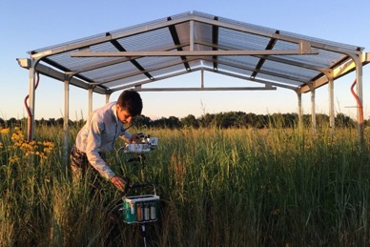
Switchgrass roots push the brakes on plant growth
BRC logo here
Background/Objective
Understand what is driving the seasonal decline in leaf photosynthesis in switchgrass.
Approach
Measure the photosynthetic rates and carbohydrate amounts of leaves and roots in switchgrass plants under rain exclusion shelters and those under ambient rainfall in Michigan.
A researcher measuring photosynthetic rates of switchgrass.
Results
The carbohydrates in the plant’s rhizomes increased four-fold with the increase of photosynthetic rates and stabilized when photosynthesis reached constant low values, suggesting that the rhizomes serve as a carbohydrate sink that limits leaf photosynthesis during the growing season.
Significance/Impacts
This research shows a potential growth limitation in bioenergy switchgrass, informing future research into how to create plants with more biomass and greater biofuel yields.
Tejera-Nieves M, et al. Seasonal decline in leaf photosynthesis in perennial switchgrass explained by sink limitations and water deficit. Frontiers in Plant Science 13, 1023571 (2023). [DOI: 10.3389/fpls.2022.1023571]

