Slide 1

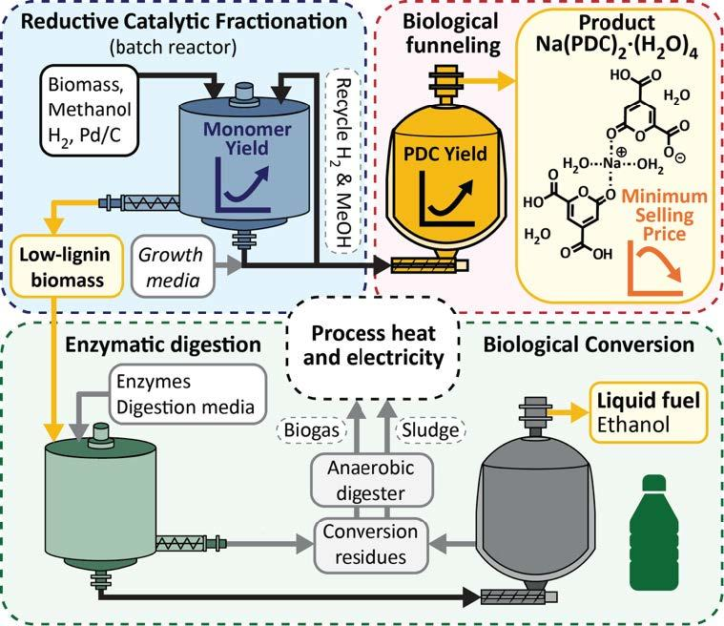
One-pot RCF process lowers cost of upgrading biomass to high-value products
Background/Objective
Successful biorefineries must maximize the value from all components of lignocellulosic biomass. Previous lignin-first designs use solvolysis to isolate lignin from the plant cell wall and catalytic processing to depolymerize it into monomers for biological funneling to value-added products.
Approach
Building on previous work evaluating stepwise processing, this study considers an integrated lignin-first biorefinery design that replaces the γ-valerolactone (GVL) fractionation and hydrogenolysis with a single reductive catalytic fractionation (RCF) step and considers how the lignin and carbohydrate fractions would be utilized.
Results
Poplar biomass was deconstructed with methanol and hydrogen gas using a palladium on carbon catalyst. The resulting hydrogenolysis oil was diluted in a minimal growth media supplemented with glucose and inoculated with an engineered strain of Novosphingobium aromaticivorans for biological funneling to 2-pyrone-4,6-dicarboxylic acid (PDC). This resulted in a calculated yield of 58.5±3.5 g PDC/kg poplar, a 7.8-fold increase over the yield from lignin isolated with GVL. Ethanol production yield of 85.3% from RCF pulp did not indicate the presence of inhibitors derived from the heterogeneous catalyst or
hydrogenolysis residue. A techno-economic analysis of this process calculated a minimum selling price for Na(PDC)₂ salt of $18.39 per kg, a $7.50 per kg (∼29%) reduction in cost due to improved monomer yields and lower biomass cost.
Significance/Impacts
This work combines experimentation with process modeling of an integrated biorefinery design to show how utilizing tandem process steps can significantly reduce operating expenses and environmental impact of upgrading lignocellulosic biomass to a portfolio of high value products.
Sener, C., et al., Integrating catalytic fractionation and microbial funneling to produce 2-pyrone-4,6-dicarboxylic acid and ethanol. Green Chemistry. (2026). [DOI:10.1039/D5GC03986J]

