Slide 1

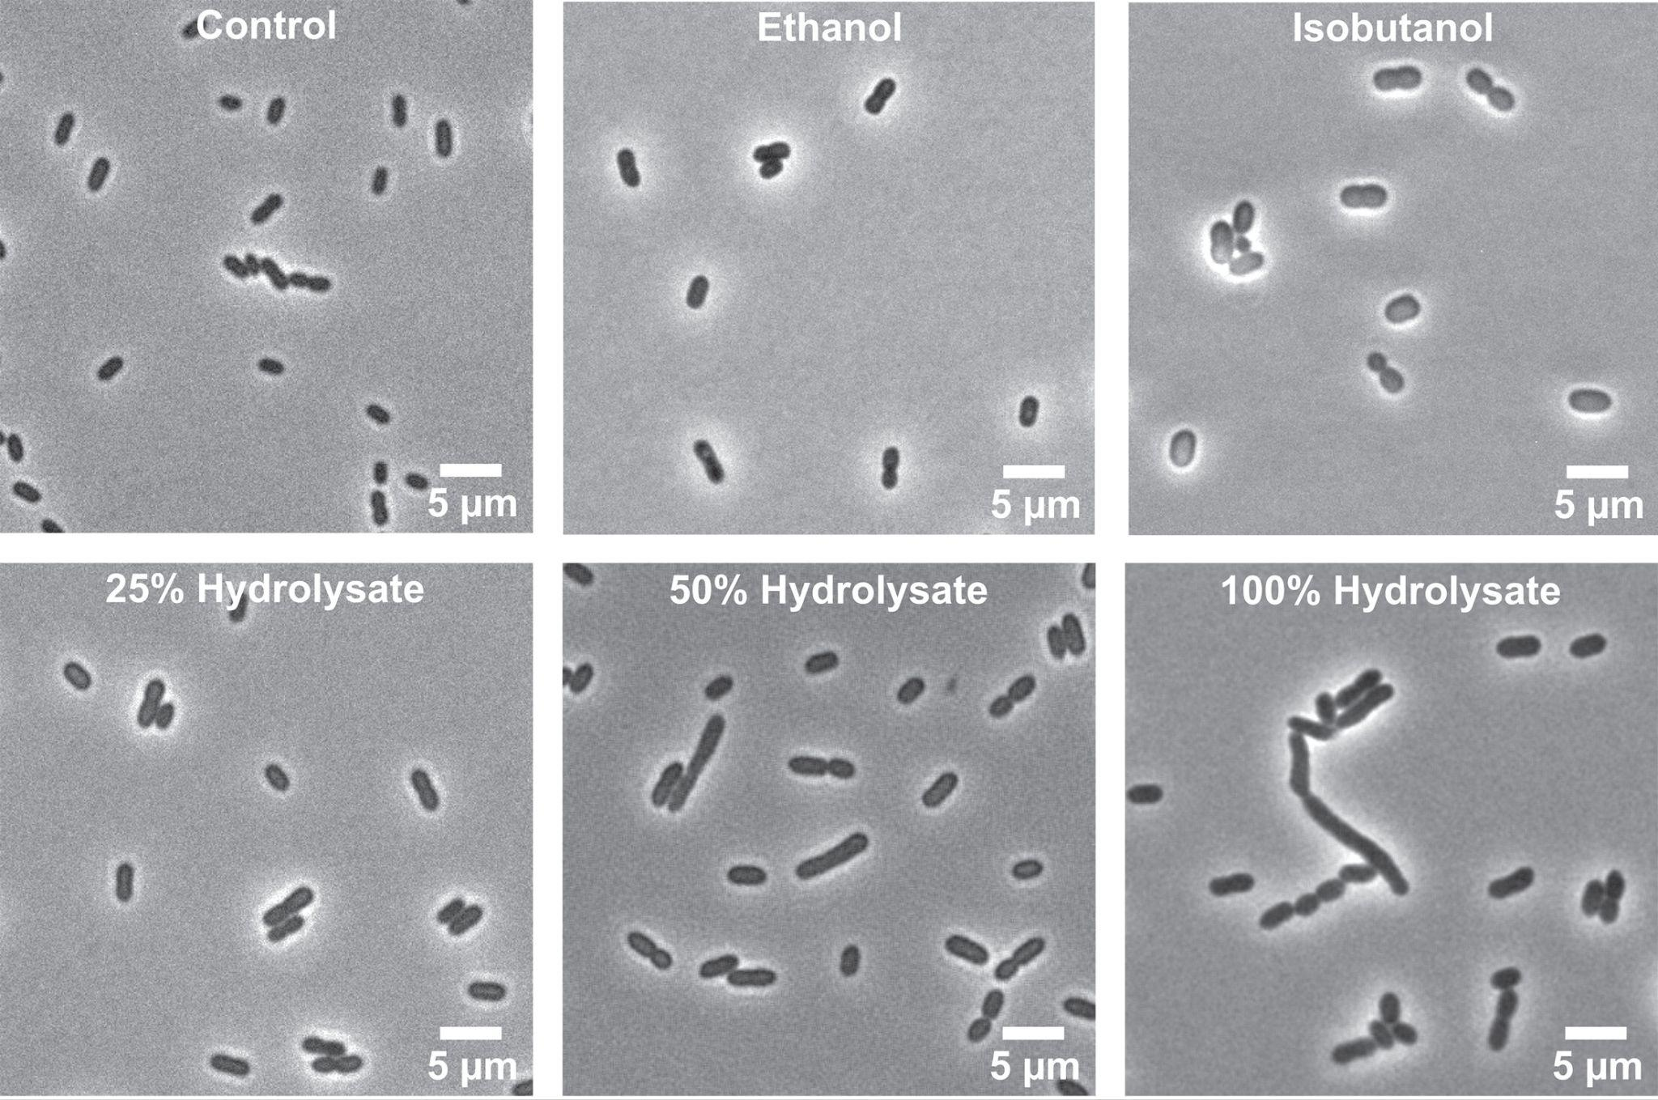
Lignocellulosic hydrolysate exposure elicits unique metabolic shifts in Zymomonas mobilis
Background/Objective
Despite growing interest in Zymomonas mobilis as a biocatalyst, its physiological response to lignocellulosic hydrolysates remains poorly understood. Here researchers investigated the physiological response of Z. mobilis to ammonia fiber expansion (AFEX)-pretreated switchgrass hydrolysate using a systems-level approach integrating LC–MS/MS-based lipidomics and shotgun proteomics.
Approach
Researchers performed lipidomic, proteomic, and microscopy analyses on samples of Z. mobilis (ATCC 31821) inoculated anaerobically in minimal media or 7% glucan-loading AFEX-pretreated switchgrass hydrolysate diluted to 25%, 50%, and 100%.
Results
Growth on hydrolysate induced substantial shifts in fatty acid and membrane phospholipid composition, alongside broad proteomic remodeling. Notably, Z. mobilis exhibited a stress response characterized by the upregulation of heat shock proteins and efflux transporters and the downregulation of cell motility proteins. Unexpectedly, hydrolysate exposure also led to a robust upregulation of the Entner–Doudoroff pathway, the ethanol fermentation pathway, and other central carbon metabolism enzymes, indicating a substantial cellular investment potentially driven by additional nutrient availability in hydrolysate.
Bright field microscopy evaluation of cell morphological changes when Z. mobilis was grown anaerobically in minimal media, ASGH diluted to 25%, 50%, and 100% (undiluted), or minimal media supplemented with ethanol (0.80 M) or isobutanol (0.15 M).
Significance/Impacts
Biomass pretreatment processes release fermentable sugars from lignocellulosic biomass, but they also generate inhibitors that can impact microbial metabolism. These insights provide a foundation for engineering Z. mobilis strains with enhanced robustness and productivity for industrial conversion of lignocellulosic feedstocks to biofuel and products.
Rivera Vazquez, J., et al. Physiological and metabolic responses of Zymomonas mobilis to lignocellulosic hydrolysate. Microbiology Spectrum, 0, e00610-25. (2025). [DOI:10.1128/spectrum.00610-25]

