Slide 1
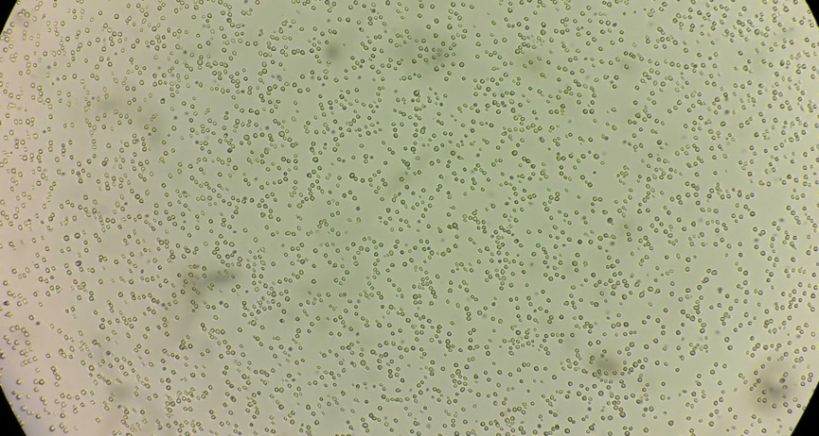
Study maps genetics, traits of yeast at unprecedented scale
BRC logo here
Background/Objective
To establish a better understanding of the yeasts responsible for nearly all bread, fermented drinks, and biofuels.
Approach
Generated and analyzed complete genome sequences of 163 strains and cataloged observable traits of 128 yeasts with different lineages, quantifying diversity and divergence within and between species and populations, several types of natural reticulation events, and the influences of ecology and incomplete lineage sorting.
Cells of the wild yeast Saccharomyces eubayanus yHRVM108 as seen through a microscope. Photo by David Peris.
Results
This work elevates the genus Saccharomyces as a model for understanding biodiversity, population structure, and macroevolutionary processes in microbial eukaryotes.
Significance/Impacts
Provides a framework for the discovery of new traits in wild strains of yeast that could be useful for brewing and other industries, including the production of fuels from plants.
Peris, D., Ubbelohde, E.J., Kuang, M.C. et al. Macroevolutionary diversity of traits and genomes in the model yeast genus Saccharomyces. Nature Communications 14, 690 (2023). [DOI:10.1038/s41467-023-36139-2]

