Slide 1
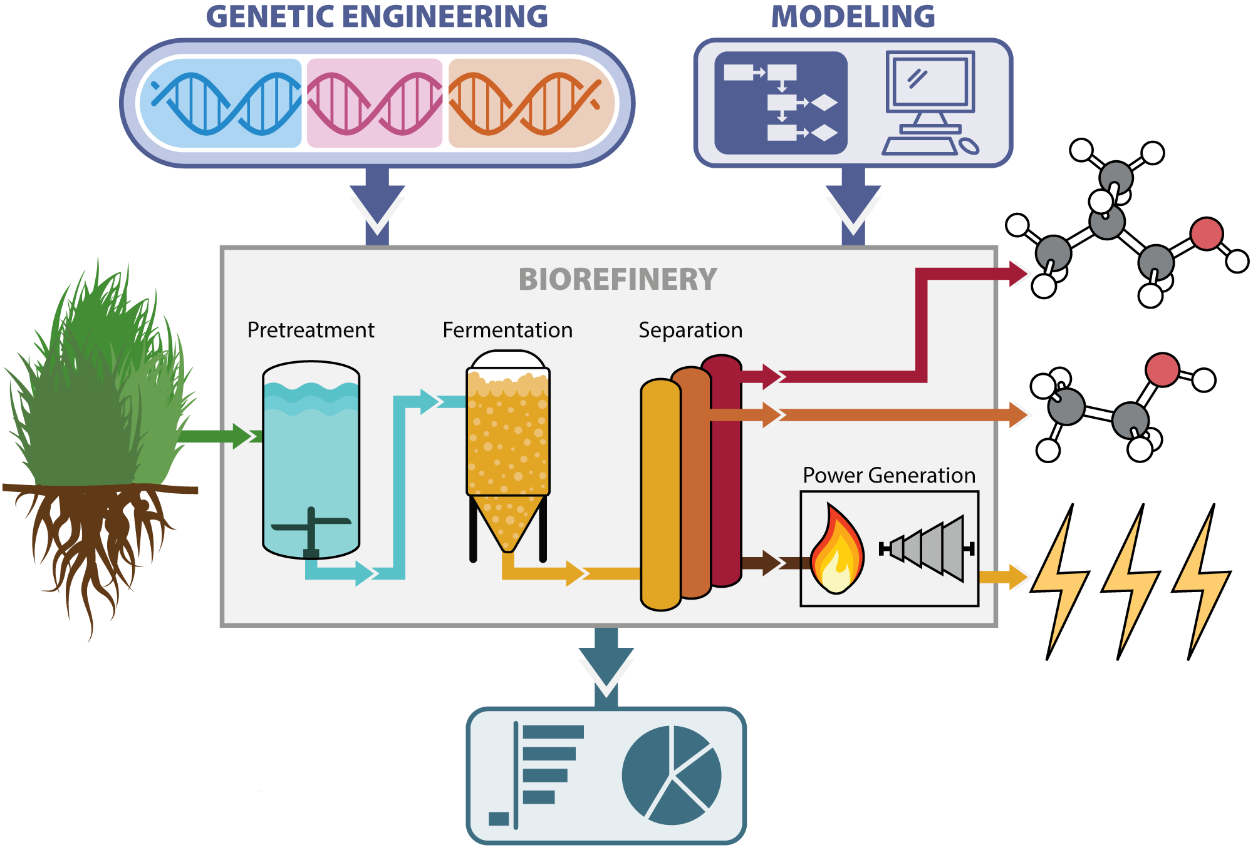
Hybrid yeast brews two alcohols for better, cheaper biofuel
BRC logo here
Background/Objective
Test the technical and economic feasibility of simultaneously producing isobutanol and ethanol from non-food plants.
Approach
Scientists created a hybrid yeast that produces isobutanol and ethanol from switchgrass. Using the lab results, they modeled the cost of industrial production and identified ways to lower production costs.
Genetic engineering was combined with economic modeling to estimate production costs.
Results
The combined break-even selling price would be $11.41 for the energy equivalent of a gallon of gasoline. However, the study found a combination of improvements could theoretically lower the cost to $4.94.
Significance/Impacts
Compared to ethanol, isobutanol has more energy, is less corrosive, and doesn’t evaporate as quickly when blended with gasoline. It can also be converted into other valuable products, including jet fuel and chemicals used to make solvents and plastics. Co-production of ethanol can increase yields and lower costs.
Pastore de Lima A.E., et al. High Yield Co-production of Isobutanol and Ethanol from Switchgrass: Experiments and Process Development. Sustainable Energy Fuels, 7, 3266-3275 (2023) [DOI: 10.1039/D2SE01741E]

