Slide 1
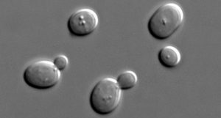
Unlocking the Potential of Xylose with Codon Optimization
BRC logo here
Background/Objective
Xylose is abundant in plant biomass, but most yeasts cannot metabolize it, despite having the required genes. Here researchers attempted to predict which yeasts would be able to consume xylose by looking at codons, the building blocks of DNA.
Approach
Submerging 332 yeast species into xylose-rich mediums, researchers observed whether species that are genetically optimized for the consumption of xylose are more likely to actually consume it.
Budding yeasts asexually reproduce by separating from or “budding” off of the parent yeast. This study looked at 332 budding yeast species.
Results
Results indicate the baseline requirement for xylose fermentation is the presence of the necessary enzymatic pathway containing XYL1, XYL2 and XYL3 genes. Overall, yeasts with multiple copies of XYL1 and highly optimized XYL2 and XYL3 genes can help predict whether the yeast species will consume xylose.
Significance/Impacts
Using this predictive power of codon optimization, scientists could engineer yeasts already established within the industry to contain the genes needed to ferment xylose.
Nalabothu, R. et al., Codon optimization improves the prediction of xylose metabolism from gene content in budding yeasts, Molecular Biology and Evolution, 40, msad111 (2023) [DOI:10.1093/molbev/msad111]

