Slide 1
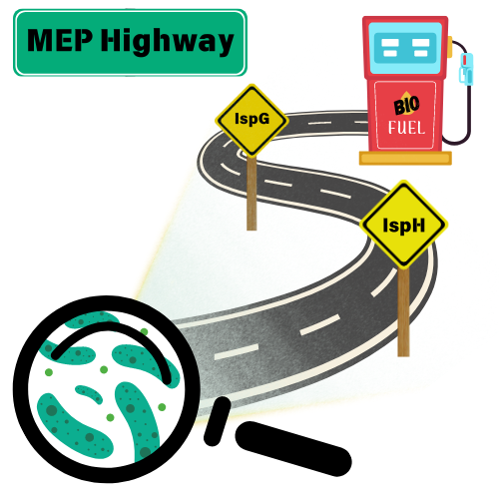
Terminal enzymes must be co-optimized to relieve MEP bottleneck in Z. mobilis
Background/Objective
Many plants and bacteria use the methylerythritol phosphate (MEP) pathway to synthesize precursors for isoprenoids, a diverse class of hydrocarbons that includes natural products, industrial chemicals and biofuels. This research investigates the function of the oxygen-sensitive enzymes IspG and IspH, known bottlenecks in the MEP pathway of the biofuel-producing microbe Zymomonas mobilis.
Approach
Researchers screened combinations of IspG and IspH enzymes for function both in the presence and absence of oxygen using E. coli as a host. The biochemical properties of the isolated IspG and IspH proteins were also analyzed for comparison.
Results
Results showed Z. mobilis IspG and IspH enzymes were more effective in the presence or absence of oxygen when they were contained in the same cell. The Z. mobilis IspG and IspH proteins were both more sensitive to oxygen than their E. coli counterparts both in vivo and in vitro, explaining why oxygen creates a bottleneck in the MEP pathway.
Z. mobilis uses the MEP pathway to convert glucose into isoprenoid precursors, a route to biofuels.
Significance/Impacts
This study identified enzymatic properties important for increased production of isoprenoid precursors, opening a valuable biological route towards sustainable energy and bioproducts. This study shows that Z. mobilis IspG and IspH must be engineered in tandem to improve the activity of the MEP pathway, guiding future strain engineering projects.
Misra J, Mettert EL, Kiley PJ, Functional analysis of the methylerythritol phosphate pathway terminal enzymes IspG and IspH from Zymomonas mobilis. Microbiology Spectrum, 0, e04256-23 (2024). [DOI:10.1128/spectrum.04256-23]

