Slide 1

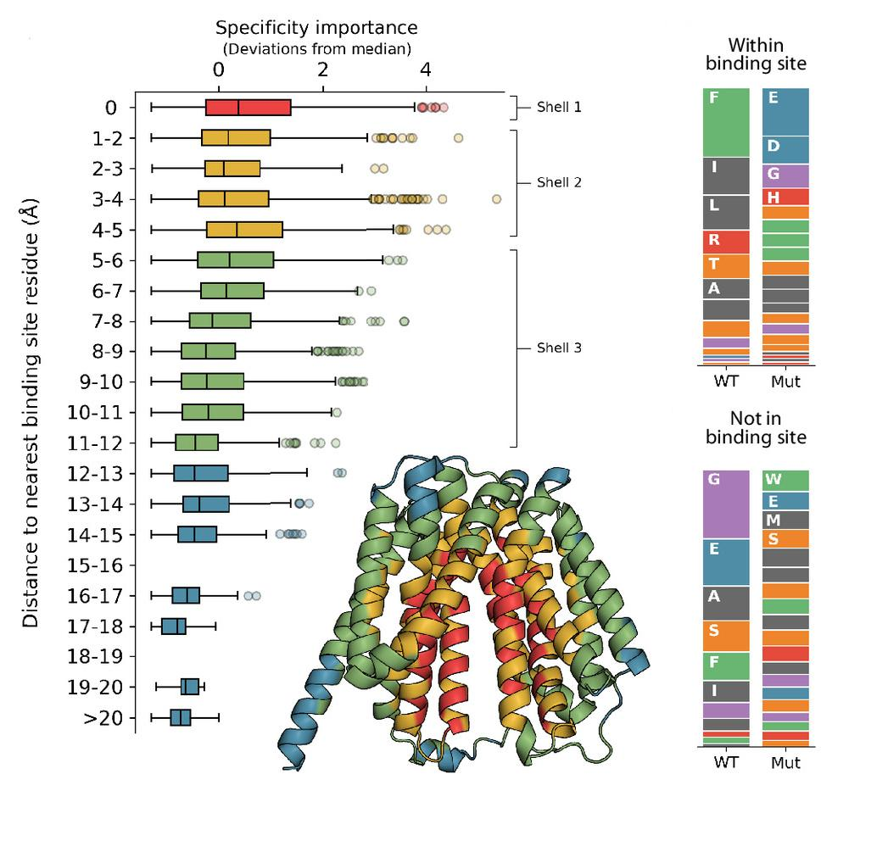
Energy efficient efflux pumps exhibit broader substrate profiles
Background/Objective
Multidrug efflux pumps harness ion gradients to export chemically diverse substrates, driving antibiotic resistance and potentially removing toxins present in lignocellulosic hydrolysates. However, the molecular principles underlying polyspecificity and energy efficiency is poorly understood.
Approach
Scientists used deep mutational scanning across eight diverse substrates and two energy conditions to analyze the NorA efflux pump, a proton-coupled transporter of Staphylococcus aureus that confers resistance to a range of antibiotics and is frequently overexpressed in multidrug resistance infections. They developed multiparametric screens to deconvolute functional effects into distinct elements of fitness: transport, energy efficiency, and stability.
Results
Data revealed that substrate specificity is not confined to the binding site, but arises from a distributed network of residues throughout the protein. Measuring pH-dependent transport efficiency as a proxy for energy coupling revealed a fundamental coupling between energy utilization and substrate breadth: Efficient variants maintain broad specificity, while inefficient variants are narrower. They developed a thermodynamic framework that links energy efficiency to substrate promiscuity. Together the findings establish fundamental principles of transporter polyspecificity and provide a blueprint for understanding, predicting, and engineering substrate selectivity.
SI scores by distance from substrate binding site (left). WT and mutant amino acid frequencies of specificity-driving mutations within or outside the binding site.
Significance/Impacts
Engineering membrane transporters to recognize and remove lignocellulosic inhibitors could improve advanced biorefinery productivity. Data generated for this project are being used to train artificial intelligence models to predict which mutations are most likely to be effective.
Miller, S. T., Henzler-Wildman, K. A., & Raman, S. Energetic and structural control of polyspecificity in a multidrug transporter. Proceedings of the National Academy of Sciences, 122, e2511892122. (2025). [DOI:10.1073/pnas.2511892122]

