Slide 1
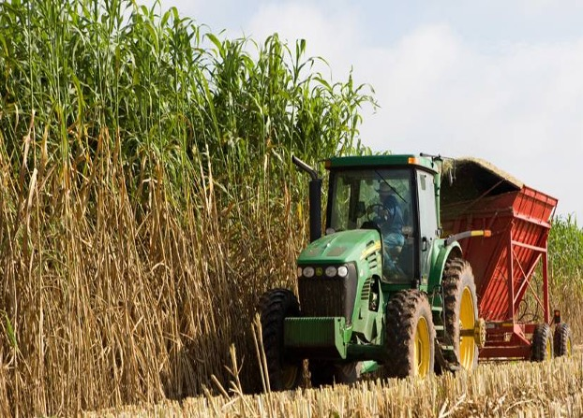
Raffinose family oligosaccharides support sorghum productivity and resilience
Background/Objective
To understand the role of raffinose family oligosaccharides (RFOs) in energy sorghum and their contribution to productivity and resilience.
Approach
Researchers examined the expression of genes involved in myo-inositol and RFO metabolism in leaves, stems, and roots of three varieties of sorghum over multiple stages of plant growth and development.
Results
Genes involved in RFO biosynthesis (SbMIPS1, SbInsPase, SbGolS1, SbRS) were more highly expressed in leaves compared to stems and roots, with peak expression early in the morning in leaves. SbGolS, SbRS, SbAGA1 and SbAGA2 were also expressed at high levels in the leaf collar and leaf
Harvesting energy sorghum in Texas.
sheath. In leaf blades, genes involved in myo-inositol biosynthesis (SbMIPS1, SbInsPase) were expressed in bundle sheath cells, whereas genes involved in galactinol and raffinose synthesis (SbGolS1, SbRS) were expressed in mesophyll cells. Results suggest raffinose synthesized from sucrose and galactinol in mesophyll cells diffuses into vascular bundles where hydrolysis releases sucrose for long distance phloem transport.
Significance/Impacts
Understanding the mechanisms that control RFOs could enable scientists to engineer more robust crops to withstand stressors made worse by climate change and pack more easily-fermentable sugars into the stem.
McKinley, Brian A. et al. Transcriptional regulation of the raffinose family oligosaccharides pathway in Sorghum bicolor reveals potential roles in leaf sucrose transport and stem sucrose accumulation. Frontiers in Plant Science 13 (2022) [DOI: 10.3389/fpls.2022.1062264]

