Slide 1
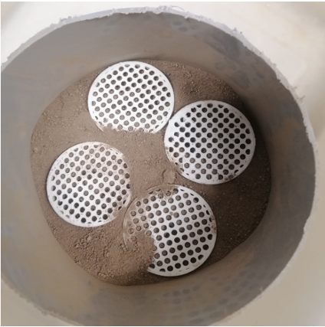
Effect of soil structure on root growth and carbon storage
BRC logo here
Background/Objective
This study investigated how the structure of soil can inhibit or advance root growth and carbon sequestration belowground.
Approach
The study compared the root growth of black-eyed Susan and switchgrass in both switchgrass and prairie soils. Each soil was separated into sieved and intact samples. Using CT scans, they compared root systems in the four soil types: sieved switchgrass, intact switchgrass, sieved prairie, and intact prairie.
Four ingrowth cores containing sieved or intact switchgrass or prairie soil.
Results
The study concluded that, for some plants, soil structure plays a pivotal role in determining how their roots will grow and how long the carbon transported from the plants will remain in the soil.
Significance/Impacts
Soil presents a huge opportunity to remove carbon dioxide from the atmosphere and store it underground. Because change is primarily driven by atmospheric carbon dioxide, it’s critical to examine how and why plants choose to optimize the amount of carbon they release into the soil.
Lucas, M., J.P. Santiago, J. Chen, A. Guber, A. Kravchenko, The soil pore structure roots encounter affects plant-derived carbon inputs and their potential protection, New Phytologist, 240, 515-528 (2023). [DOI:10.1111/nph.19159]

