Slide 1
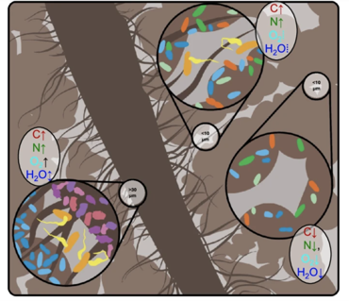
Bioenergy crops shape underground micro-ecosystems​
Background/Objective
To determine the effects of plant diversity in bioenergy cropping systems on functioning of soil bacterial communities and subsequent impacts on soil carbon processing.​
Approach
Researchers used X-ray computed microtomography to characterize soil pore structure and quantify the distribution of particular organic matter as well as pore-level water distribution in three vegetation systems: corn, monoculture switchgrass, and restored prairie. They used carbon-labeled glucose and stable isotope probing to identify microorganisms metabolizing glucose-derived carbon, and analytic software to estimate the identities and functions of the microbes.​
Results
Results demonstrate striking differences between each vegetal system’s soil pore characteristics, connecting micro-level contrast between large and small soil pores in microbial diversity, composition, and carbon distribution strategies to the structure of hydraulic connections within each system.​
Classification concept of soil microhabitats: large pores (“Lp” left) substrate-rich small pores (“SpRich” center) and substrate-poor small pores (“SpPoor” right).
Significance/Impacts
The plant systems were shown to alter the distribution and characteristics of soil pores, as well as the microbial communities and their carbon processing strategies. These results enhanced the understanding of the mechanisms through which increasing plant diversity in switchgrass-based bioenergy cropping systems can improve their soil carbon sequestration capacity. The results enabled the team to propose a microbial habitat classification concept, providing a framework for the generalization of carbon processing within other soil matrices. ​
Li, Z., Kravchenko, A.N., Cupples, A. et al. Composition and metabolism of microbial communities in soil pores. Nature Communications 15, 3578 (2024). https://doi.org/10.1038/s41467-024-47755-x

