Slide 1
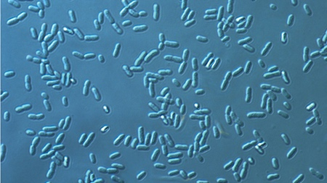
Researchers pinpoint bottlenecks limiting microbial production of biofuel and chemicals
BRC logo here
Background/Objective
Identify biological bottlenecks that inhibit isoprenoid production by the bacteria Zymomonas mobilis.
Approach
Genetically engineered strains of Zymomonas to produce more of certain enzymes, or proteins that speed up the metabolic process.
The bacteria Zymomonis mobilis.
Results
By measuring changes in the level of metabolic intermediates, or molecules that can be converted to isoprenoids, researchers were able to identify the primary enzyme limiting carbon metabolism as well as secondary bottlenecks that occurred when levels of the first enzyme were increased.
Significance/Impacts
Identifying the isoprenoid production bottlenecks represents an initial step toward using these bacteria for industrial production of biofuels and other products currently derived from petroleum.
Khana, D. et al. Systematic Analysis of Metabolic Bottlenecks in the Methylerythritol 4-Phosphate (MEP) Pathway of Zymomonas mobilis. MSystems, 8, 2 (2023). [DOI:10.1128/msystems.00092-23]

