Slide 1
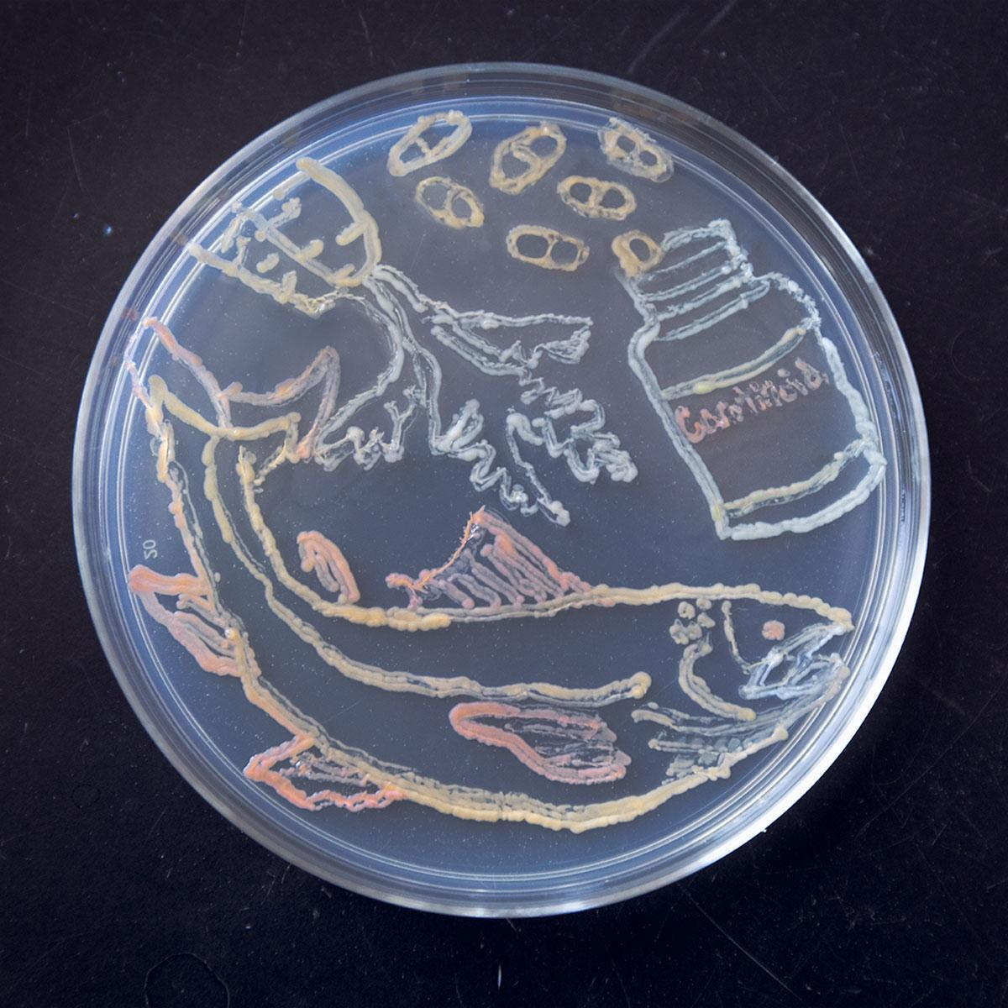
Multitasking Microbes could improve biofuel economics, climate impact
BRC logo here
Background/Objective
To engineer bacteria to produce valuable carotenoids when grown on aromatics derived from biomass lignin, a major part of plant cells that is difficult to convert into valuable products.
Approach
Scientists modified the genome of a natural aromatic-metabolizing bacterium, Novosphingobium aromaticivorans, to produce valuable carotenoids and grew the engineered strains on both laboratory media and a mixture of aromatics from sorghum. They also introduced mutations allowing cells to produce both carotenoids and 2-pyrone-4,6-dicarboxylic acid (PDC), a building block for biodegradable polymers.
N. aromaticivorans can be engineered to produce the carotenoids β-carotene, lycopene, and zeaxanthin from pre-treated biomass.
Results
Mutant strains grown on sorghum liquor produced the carotenoids beta-carotene, lycopene, zeaxanthin, and astaxanthin concurrently with PDC.
Significance/Impacts
Using microbes to produce multiple products from an underutilized renewable carbon source could help make plant-based fuels and chemicals more environmentally and economically sustainable.
Hall, B., et al. Production of carotenoids from aromatics and pretreated lignocelullosic biomass by Novosphingobium aromaticivorans. Applied and Environmental Microbiology 0, e01268-23 (2023). [DOI:10.1128/aem.01268-23]

