Slide 1
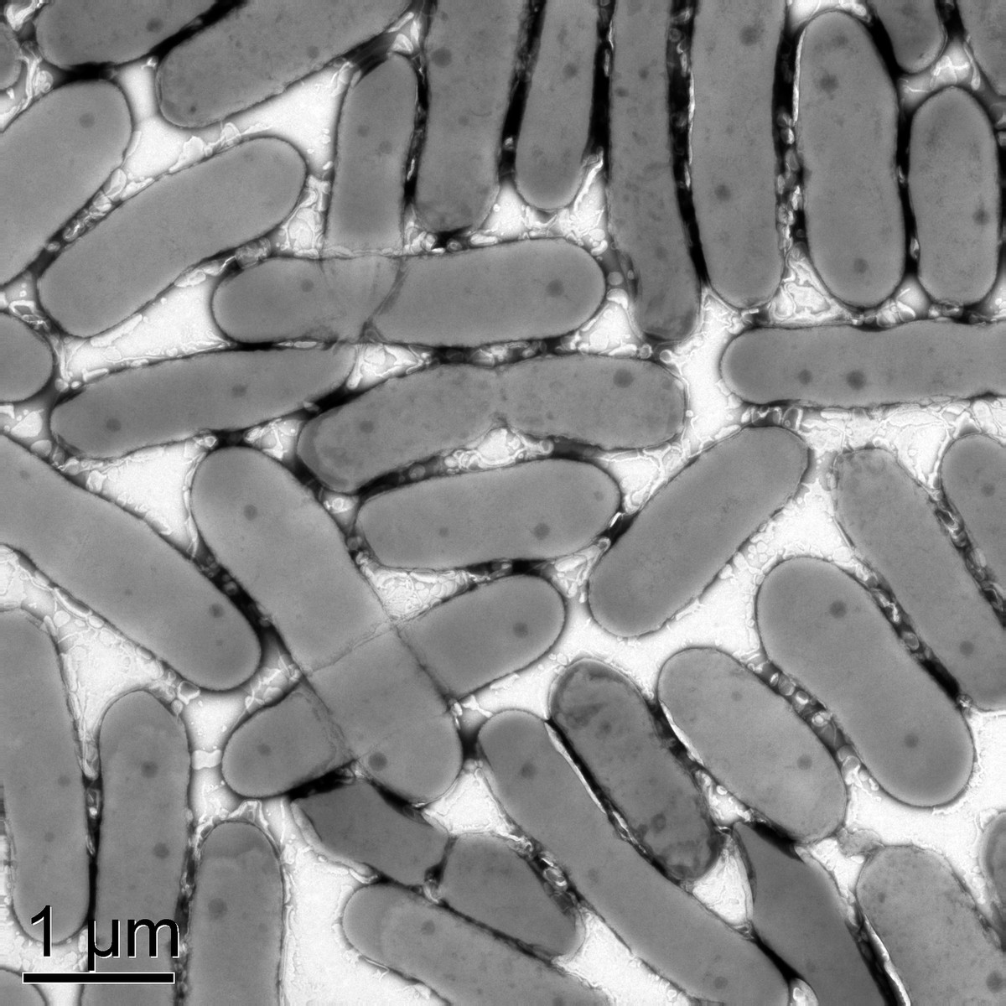
Researchers develop genetic toolkit for engineering Alphaproteobacteria
Background/Objective
To develop facile and reliable genetic tools to target essential or other specific genes in the Alphaproteobacteria Novosphingobium aromaticivorans and Rhodobacter sphaeroides, which show promise as organisms that can be engineered to convert plant lignin and sugars into biofuels and commodity chemicals.
Approach
Researchers screened a synthetic promoter library to identify inducible promoters with strong, regulated activity in both organisms. Combining Tn7 transposition with those promoters, they established CRISPR interference systems that can target essential genes and modulate engineered pathways.
Results
The study demonstrated that Tn7 transposition is an effective approach for introducing engineered DNA into the chromosomes of N. aromaticivorans and R. sphaeroides.
Rhodobacter sphaeroides cells viewed through a microscope.
Significance/Impacts
Increasing our understanding of the microbial world can improve human health, agriculture, and the environment. Researchers anticipate these systems will facilitate both genetic engineering and gene function discovery efforts in these industrially important species and other Alphaproteobacteria.
Hall, A. N., et al. Tools for genetic engineering and gene expression control in Novosphingobium aromaticivorans and Rhodobacter sphaeroides. Applied and Environmental Microbiology, 0, e00348-24. (2024). [DOI:10.1128/aem.00348-24]

