Slide 1
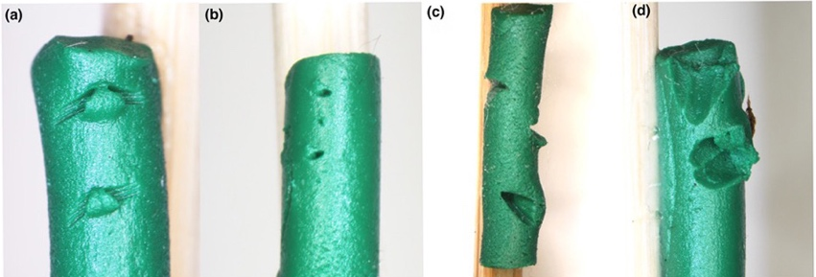
Perennial crops promote natural pest control
BRC logo here
Background/Objective
Evaluate natural pest control of herbivores in energy cropping systems
Approach
Placed plasticine “caterpillars” in 10 cropping systems, including annual row crops like corn and sorghum as well as perennial grasses and poplar trees to record imprints from attacks.
Plasticine sentinel “caterpillars” show imprints from predators: From left, chewing arthropods, (b) arthropod proboscis or ovipositor, (c) bird beak, and (d) rodent teeth
Results
In general predators were more likely to attack herbivores in perennial systems. In annual crop systems, birds and small mammals carried out nearly all the attacks, especially during the early growing season. By late summer, there were almost no attacks in the canopies of annual crops, while insects remained active in perennial canopies.
Significance/Impacts
Nearly all plans for slowing climate change require expanded use of bioenergy. The type of plants and how they are placed on the landscape will affect natural pest control.
Haan, N. L., & Landis, D. A., Pest suppression potential varies across 10 bioenergy cropping systems, GCB Bioenergy, 15, 765– 775 (2023). [DOI:10.1111/gcbb.13053]

