Slide 1
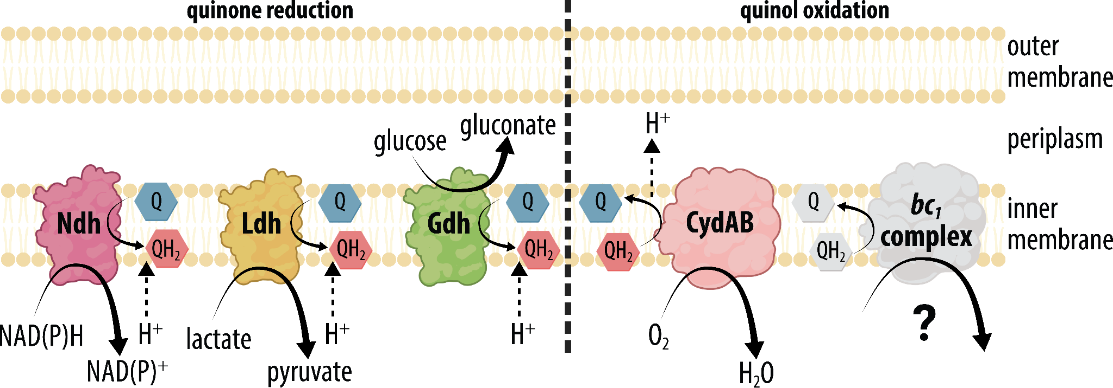
Study solves Z. mobilis respiration puzzle
BRC logo here
Background/Objective
To understand the role of respiration for the bacterium Zymomonas mobilis, which grows better without oxygen despite having the genes needed for respiration.
Approach
Scientists obtained clean deletions of two respiratory genes (ndh and cydAB) from Z. mobilis and showed that deletion of cydAB completely inhibited oxygen respiration and dramatically reduced growth in the presence of oxygen. Both respiration and aerobic growth were restored by expressing a heterologous, water-forming NADH oxidase, noxE.
Proposed electron transport chain the bacterium Zymomonas mobilis uses to capture chemical energy.
Results
This result shows that the main role of the electron transport chain in Z. mobilis is reducing the intracellular concentration of molecular oxygen, helping to explain why it is beneficial for Z. mobilis to use electron transport chain complexes that have little capacity to contribute to oxidative phosphorylation.
Significance/Impacts
These results suggest the respiratory pathway should not be deleted from chassis strains for industrial production because this would yield a strain that is intolerant of oxygen, which is more difficult to manage in industrial settings.
Felczak, Magdalena M. & TerAvest, Michaela A., Respiration is essential for aerobic growth of Zymomonas mobilils Zm4. mBio 14, e02043-23 (2023). [DOI:10.1128/mbio.02043-23]

