Slide 1
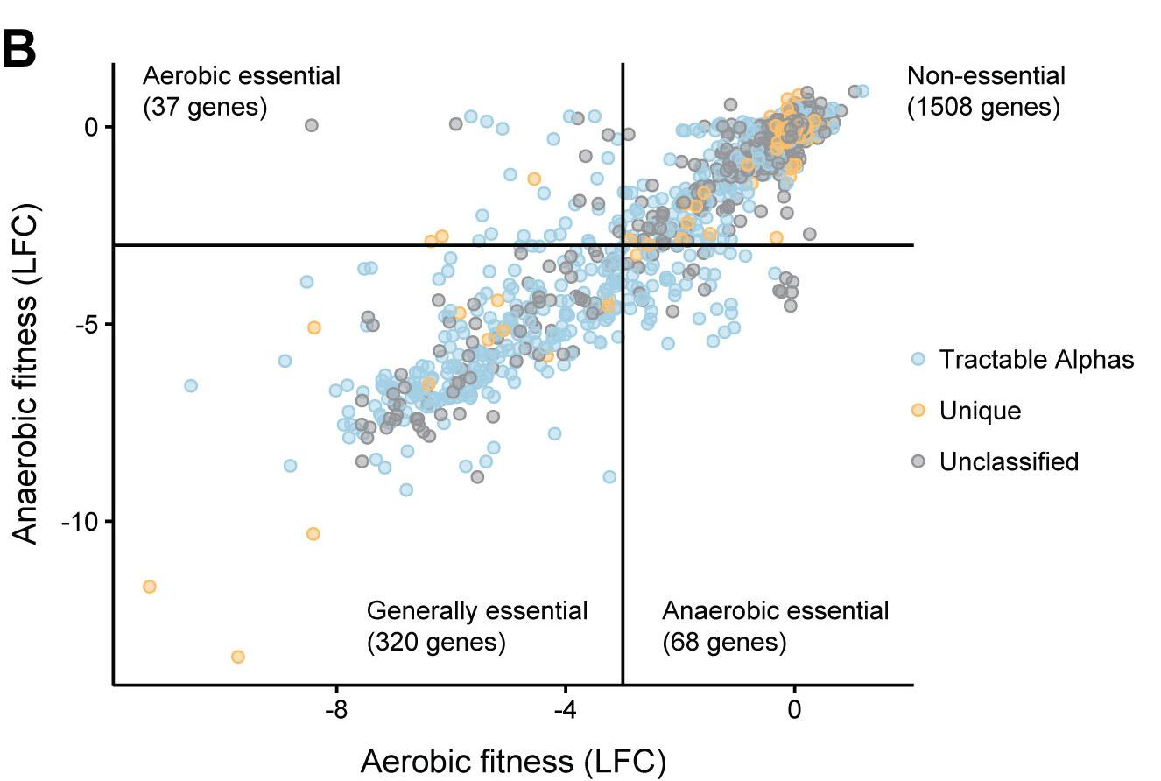
The genetics of aerotolerant growth in Zymomonas mobilis
Background/Objective
To define and characterize generally and conditionally essential genes in Zymomonas mobilis, a reduced-genome, aerotolerant alphaproteobacterium.
Approach
Scientists with the Great Lakes Bioenergy Research Center used genome-scale CRISPRi sequencing to systematically identify and characterize Z. mobilis genes conditionally essential for aerotolerant or anaerobic growth or generally essential across both conditions.
Results
The DNA repair gene recJ was critical only for aerobic growth but reduced the mutation rate under both conditions. Genes encoding the F₁F_{O} ATP synthase and Rhodobacter nitrogen fixation (Rnf) respiratory complex are required for the anaerobic growth. Rnf knockdown strains accumulated isoprenoid biosynthesis intermediates, suggesting a key role for Rnf in powering essential biosynthetic reactions.
Significance/Impacts
With fewer than half the protein-encoding genes of closely related species, Z. mobilis is an emerging model for bacteria with naturally reduced genomes and has favorable properties as an industrial platform, including excellent anaerobic fermentation and robust growth in the presence or absence of oxygen and high concentrations of ethanol and other inhibitors in plant-derived fermentation substrates.
Enright, Amy L., Banta, Amy B., Ward, Ryan D., Rivera Vazquez, Julio, Felczak, Magdalena M., et al. The genetics of aerotolerant growth in an alphaproteobacterium with a naturally reduced genome. mBio, 14, e01487-23. (2023) [DOI:10.1128/mbio.01487-23]

