Slide 1
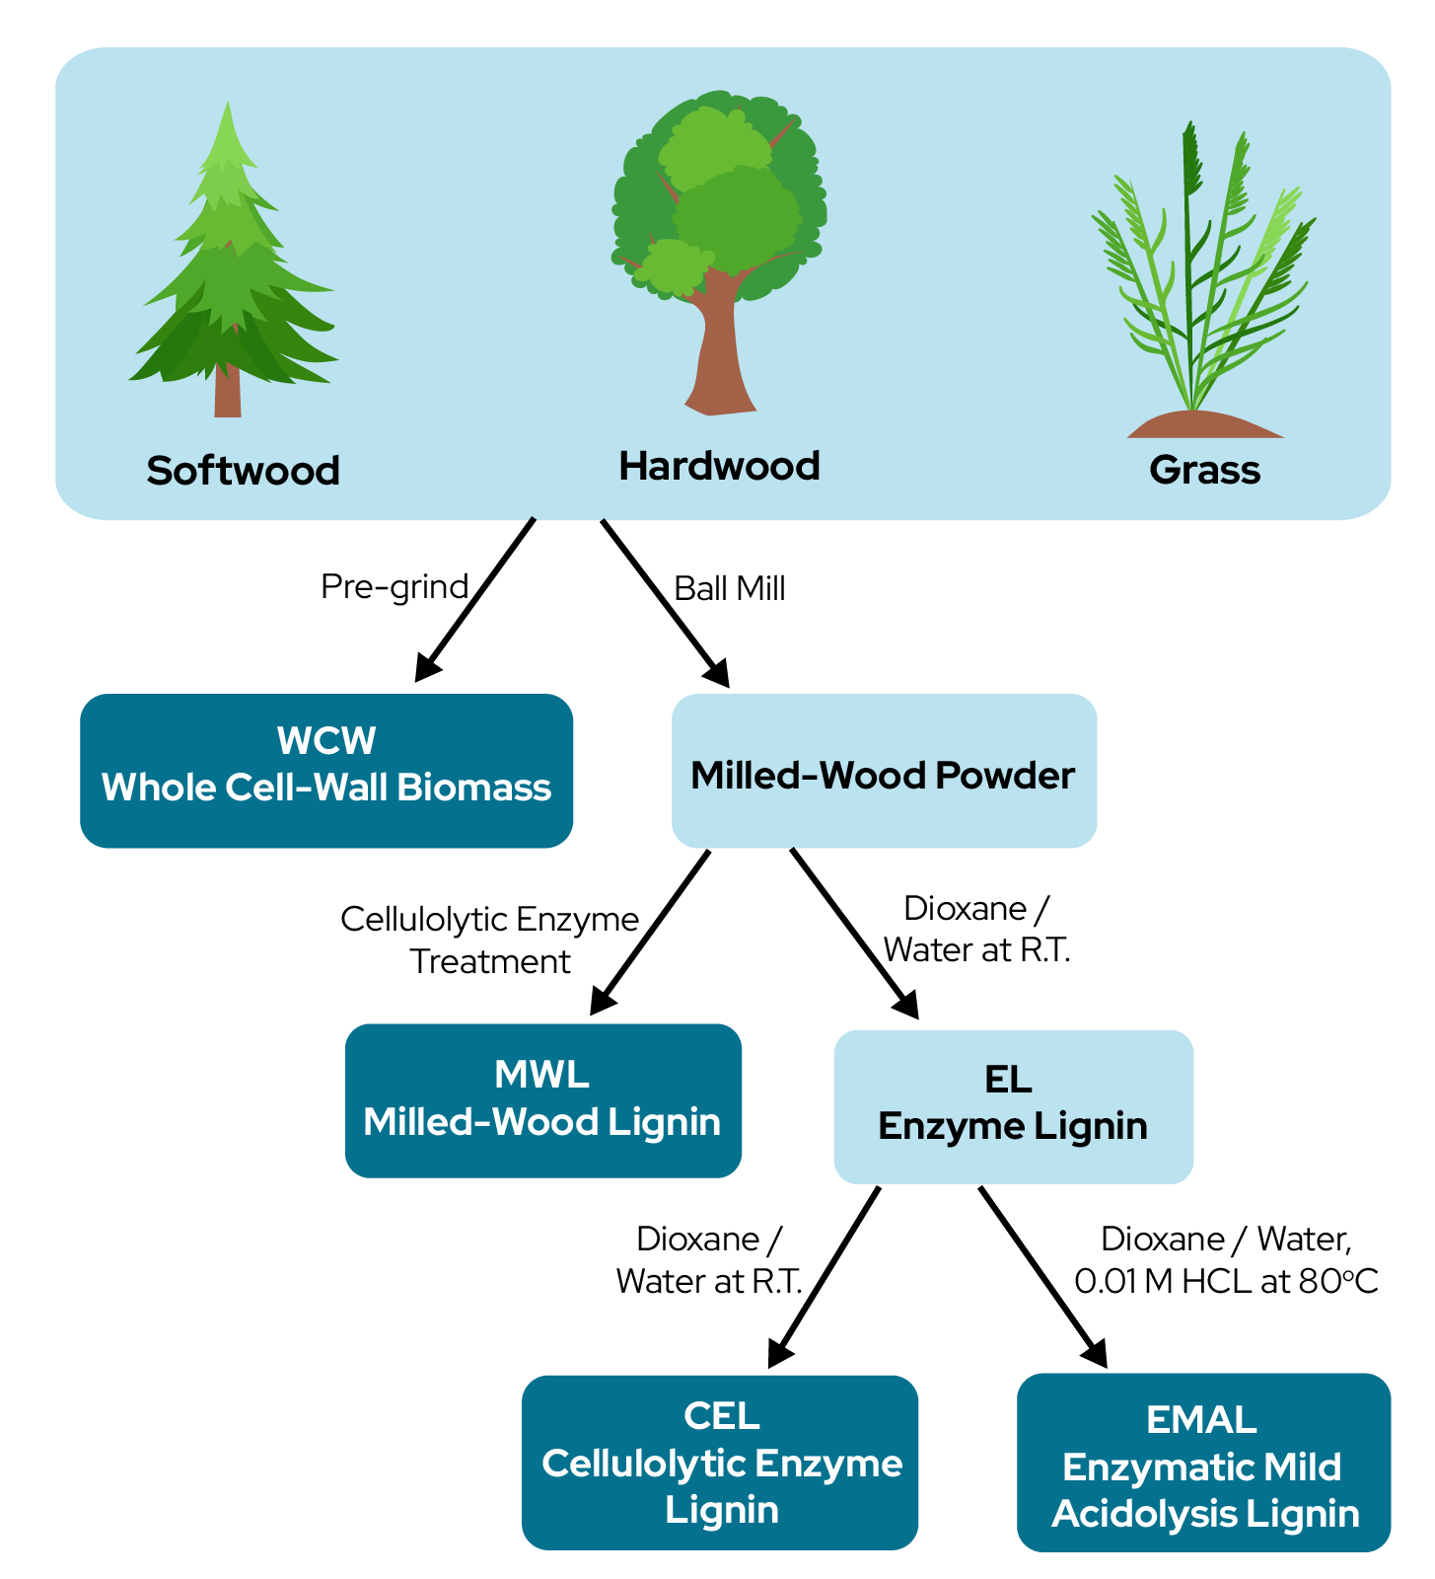
Study provides guidelines for selecting best lignin isolation techniques for research
Background/Objective
Lignin, a complex heterogeneous polymer that forms plant biomass structures, is a promising candidate in the biofuel industry because of its aromatic constitution. Although milled wood, enzymatic, cellulolytic enzyme, and enzymatic mild-acidosis lignins have all been studied on behalf of native lignin, they are all the result of different separation strategies and therefore may have differing structures. This study aimed to compare these separation strategies and determine their effects on lignin structure in softwoods, hardwoods, and grasses.
Approach
Milled wood, enzymatic, cellulolytic enzyme, and enzymatic mild-acidosis lignins were all extracted from pine, birch, and corn stover, then analyzed via carbohydrate content analysis, saponification, gel-permeation chromatography, two-dimensional nuclear magnetic resonance spectroscopy, derivatization followed by reductive cleavage, and hydrogenolysis and compared with the original biomass whole-cell-wall material.
Results
Though milled-wood lignin is an attractive candidate in studies due to its solubility and other properties, it is the least representative of native lignin across wood types. Although imperfect, enzyme lignin and cellulolytic enzyme lignin were shown to be most representative of native softwood and hardwood lignin.
Lignin was isolated from softwood (pine) hardwood (birch) and grass (corn stover) through several different extraction techniques.
Significance/Impacts
Understanding the structure of lignin is crucial to the development of this renewable energy source. This analysis may assist future researchers in the field determine which extraction technique is most effective in preserving the native lignin characteristics for their studies.
Chen, Mingjie, et al., Selecting Suitable Near-Native Lignins for Research, Journal of Agricultural and Food Chemistry, 71, 20751–20761, (2023). [DOI:10.1021/acs.jafc.3c04973]

