Slide 1
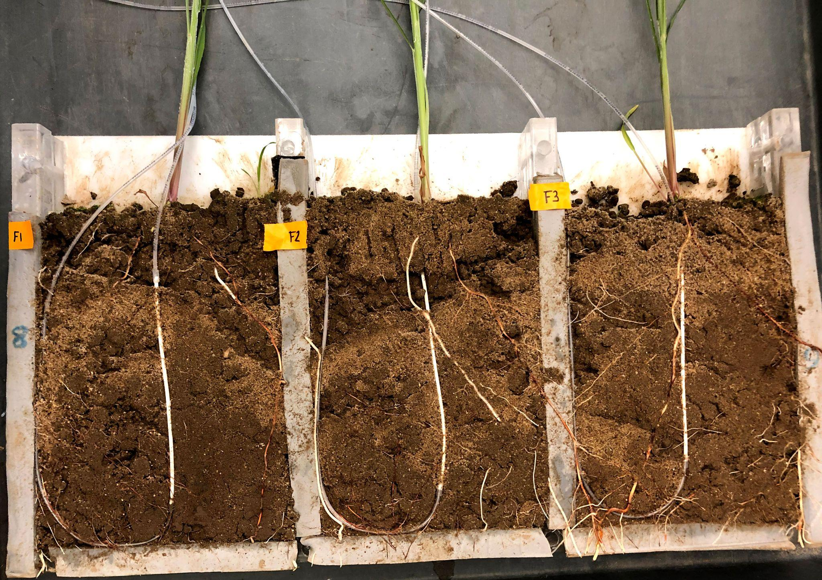
Plant chemicals have varied effects on root system microbes
BRC logo here
Background/Objective
To understand how terpenes and terpenoids affect the bacteria and fungi that live around the roots of two plant species, switchgrass and sorghum.
Approach
In a pair of studies, scientists assessed the impact of terpenes and terpenoids on bacterial and fungal isolates and communities in the area around the root systems of switchgrass and sorghum.
Terpenes were delivered through artificial roots in this “rhizobox” to test the impact on soil bacteria and fungi.
Results
The results showed terpenes and terpenoids have variable effects on specific microbes depending on the compound, location, and timing.
Significance/Impacts
Understanding the role of terpenes and terpenoids could help scientists breed or engineer crops that grow bigger and that attract helpful microbes while resisting diseases brought about by climate change with fewer pesticides.
Chou MY, et al. Terpenes modulate bacterial and fungal growth and sorghum rhizobiome communities. Microbiology Spectrum 11, e01332-23 (2023). [DOI:10.1128/spectrum.01332-23]
Li, X., et al. Anti-fungal bioactive terpenoids in the bioenergy crop switchgrass (Panicum virgatum) may contribute to ecotype-specific microbiome composition. Communications Biology 6, 917 (2023). [DOI:10.1038/s42003-023-05290-3]

