Slide 1

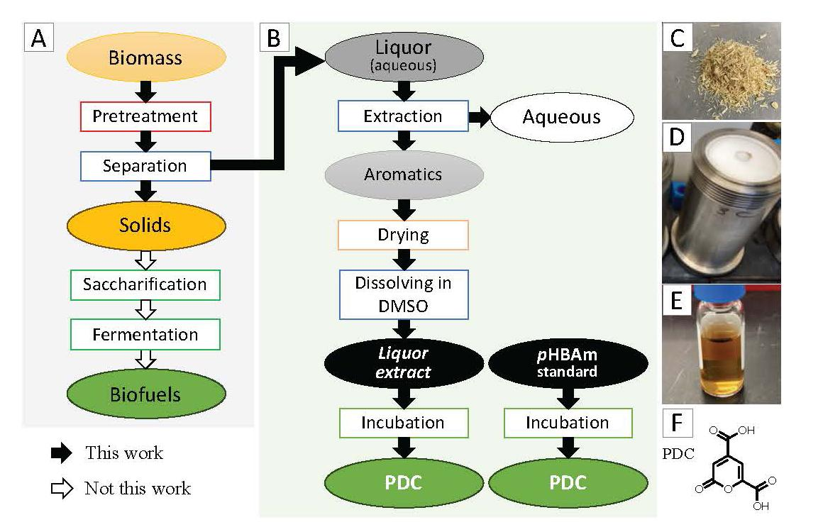
Bioconversion of phenolics in biomass spent liquor into industrial chemicals
Background/Objective
Spent liquors from biomass pretreatment could provide a source for renewable chemical production. This study characterized the phenolics in spent liquor from aqueous ammonia pretreatment of poplar, investigated the impact of metal additives on the formation of phenolics during pretreatment, and explored valorization microbial transformation.
Approach
Researchers used chromatographic fractionation, nuclear magnetic resonance, and liquid-chromatography mass spectrometry to characterize phenolic content of spent liquors from aqueous ammonia pretreatment of poplar wood. Biotransformation of the extracted phenolics into 2-pyrone-4,6-dicarboxylic acid (PDC) was assessed using an engineered strain of Novosphingobium aromaticivorans DSM12444.
Results
The main phenolics identified were phenol, p-hydroxybenzamide (pHBAm), and p-hydroxybenzoic acid (pHBA), of which pHBAm and pHBA were produced from the ester-linked p-hydroxybenzoates in poplar wood and phenol was produced from pHBA via decarboxylation. Compared to the control, metal additives reduced the phenolic recovery and phenol yield. Biotransformation of pHBAm to PDC was shown to be possible in the presence of pHBA, but not when pHBAm was the sole phenolic substrate. The phenol present was not transformed to PDC and didn’t inhibit PDC production.
Significance/Impacts
This study demonstrates that the phenolic amide in spent liquor from ammonia pretreatment could be valorized via biotransformation using N. aromaticivorans, potentially expand its use as a microbial chassis for converting plant-derived compounds to useful products.
Zhou, S., et al., Biotransformation of Phenolics in Spent Liquor from Aqueous Ammonia Pretreatment. ChemSusChem, n/a, 2500881. [DOI:10.1002/cssc.202500881]

