Slide 1
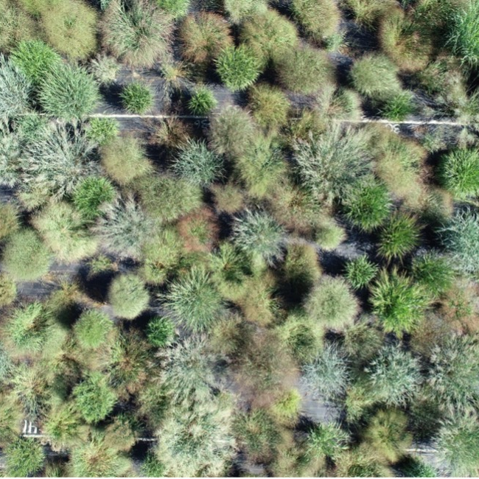
Study evaluates potential of genomic prediction to improve switchgrass productivity
Background/Objective
Bioenergy crops like switchgrass can pull carbon dioxide from the air and store it in soil while also providing a source of sustainable fuel, but gains in productivity are needed in order to be commercially viable. To improve switchgrass breeding strategies with limited resources by analyzing plant performance across diverse environments, evaluating yield surrogate traits, and developing genomic models to predict biomass yield efficiently.
Approach
Researchers evaluated 630 genotypes from 4 switchgrass populations (Gulf, Midwest, Coastal, and Texas) at 10 sites from Texas to South Dakota. They measured biomass yield, plant height, and flowering time at each site and analyzed the data to visualize genotype-by-environment interactions, estimate genetic correlations between traits, and develop genomic prediction models. They compared predictive abilities across different subpopulations and regions to assess the broad applicability of the approaches.
Results
Plant performance varied mainly along a north-south axis, with different switchgrass types performing better in regions similar to their origins. Later flowering time and taller plant height were generally associated with higher biomass yield across all regions and switchgrass types. Genomic prediction models showed high predictive ability (>0.55) with data from 1 to 5 sites included in the training set.
A switchgrass diversity panel in Michigan, one of 10 sites across the central plains researchers used to compare plant genomes and size.
Significance/Impacts
These results provide a framework which can significantly accelerate breeding programs developing new high-yielding cultivars for different regions.
Tilhou, Neal W., et al. Genomic prediction of regional-scale performance in switchgrass (Panicum virgatum) by accounting for genotype-by-environment variation and yield surrogate traits. G3 Genes|Genomes|Genetics, jkae159 (2024). [DOI:10.1093/g3journal/jkae159]
Tilhou, Neal W., et al. Empirical comparison of genomic selection to phenotypic selection for biomass yield of switchgrass. Agronomy Journal, 116, 2318–2327 (2024). [DOI:10.1002/agj2.21639]

