Slide 1

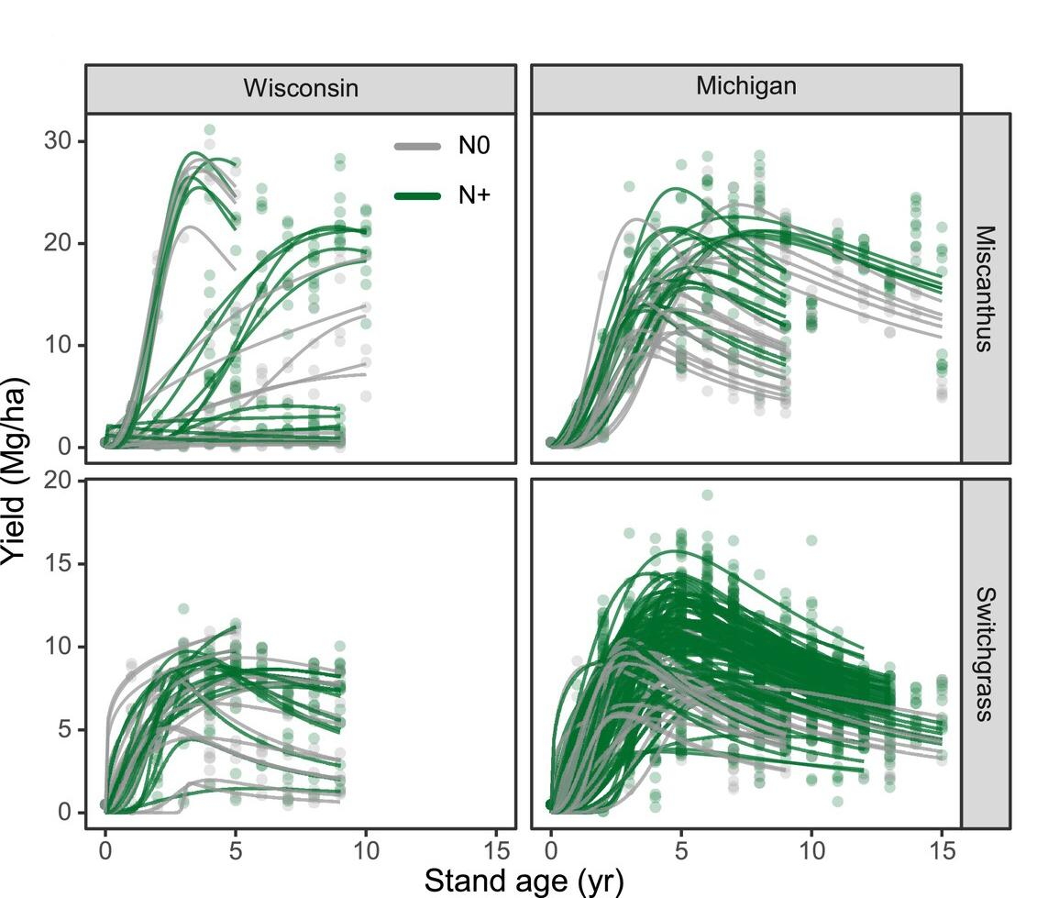
Switchgrass and miscanthus long-term yield patterns reveal productivity declines
Background/Objective
Switchgrass and miscanthus are bioenergy crops that can sequester carbon in the soil and provide substantial feedstock for biofuels and products. However, uncertainty over long-term yields limit wider adoption and their potential environmental benefits. While researchers have observed yield declines, a better understanding of the mechanisms driving them is needed to develop better breeding and management practices.
Approach
Researchers analyzed over 200 plantings of switchgrass and miscanthus at 12 sites across Michigan and Wisconsin with data spanning 5 to 15 years. Farm-to-gate economic analysis identified the most profitable rotations and economic relevance of fertilization.
Results
Analysis revealed a consistent two-phase dynamic. In the yield-building phase, peak yields occurred within 4 to 5 years after planting followed by a yield-decline phase in which switchgrass and miscanthus lost 30%-47% and 14%-40% of peak yields, respectively. Weather conditions had little impact. Added nitrogen increased peak yields by 10%-20% and attenuated decline by 20%-50%. Economic analysis suggests replanting switchgrass and miscanthus 5 and 9 years, respectively, following peak yields maximizes profit over a 30-year period.
Long-term yield dynamic of Miscanthus and Switchgrass end-of-season biomass across Michigan and Wiscosin.
Significance/Impacts
Uncertainty about long-term yields limits wider adoption of these bioenergy crops, and under-performing stands could lead to crop abandonment or limit environmental benefits if replanted too frequently. These results call for further management and breeding strategies to mitigate yield decline and for reparameterization of global bioenergy models with carbon capture and storage, which may overestimate yields and the economic and environmental benefits.
Tejera-Nieves, M. D., et al., Switchgrass (Panicum Virgatum) and Miscanthus (Miscanthus × Giganteus) Long-Term Yield Patterns Reveal Consistent Productivity Declines. GCB Bioenergy, 17, e70088. (2025). [DOI:10.1111/gcbb.70088]

