Slide 1

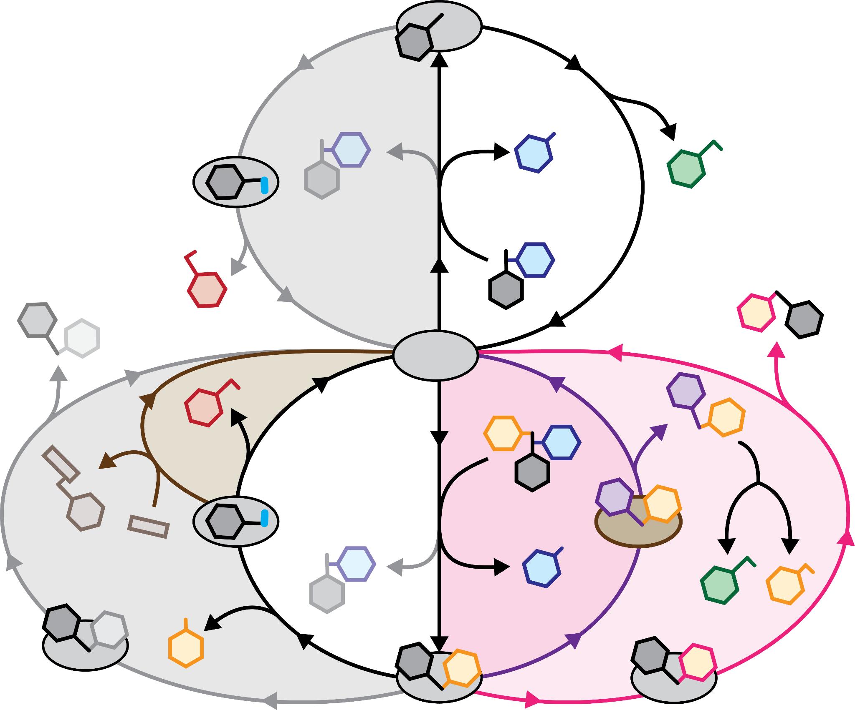
Analysis of poplar hydrogenolysis reveals new pathways and products
Background/Objective
Grasses and some tree species have naturally γ-acylated lignins. Poplar lignins have para-hydroxybenzoate groups on 1-15% of syringyl subunits. During hydrogenolysis, it is generally assumed that p-hydroxybenzoate is cleaved before the deacylated lignin is depolymerized. Here, scientists showed how the presence of a γ-acylated group alters the product portfolio produced by hydrogenolysis with palladium on carbon (Pd/C) as the catalyst.
Approach
Scientists synthesized a family of β-ether model compounds in which the γ-OH was acylated with p-hydroxybenzoate and subjected them to hydrogenolysis using Pd/C in methanol. The composition of the resulting mixture was analyzed with gas chromatography-mass spectrometry.
Results
The product distribution after hydrogenolysis shows that depolymerization starts by cleavage of the β-aryl ether bond to form the arylpropenyl esters that are subsequently converted to arylpropyl esters, ethers, the arylpropanols, the arylpropanes, p-hyrdoxybenzoic acid, or methyl p-hydroxybenzoate. The experiment showed that the typically reductive catalytic surface conditions could be temporarily primed for oxidative addition of a hydroxy group to the p-hydroxybenzoate to form 2,4-dihydroxybenzoate that subsequently converts to 2,4-dihydroxycyclohex-1-enoate.
The β-aryl ether hydrogenolysis catalytic cycles product portfolio (top) is simpler than when a γ-acylated group is present (bottom), which mostly proceed through catalytic cycles that produce reduced and oxidized products.
Significance/Impacts
These previously unrecognized products and pathways are key to understanding the different hydrogenolysis product distributions from naturally acylated lignins in biomass-conversion feedstocks. This work provides a template for designing cascading multi-catalytic step reaction sequences that use one heterogeneous catalytic surface and include both reductive and oxidative steps to target specific high-value products.
Sener, C., Timokhin, V. I., Hellinger, J., Ralph, J., & Karlen, S. D. Pd/C promotes C–H bond activation and oxidation of p-hydroxybenzoate during hydrogenolysis of poplar. Nature Communications, 16, 5259. (2025). [DOI:10.1038/s41467-025-60270-x]

