Slide 1
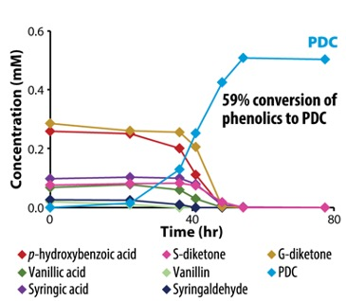
Patent approved for lignin to polyester precursor conversion process
Background/Objective
The cost of manufacturing plant-based biofuels has limited competition with cheaper fossil fuels. By engineering one candidate microbe, Novosphingobium aromaticivorans, to funnel heterogeneous mixtures of lignin-derived aromatic compounds to 2-pyrone-4,6-dicarboxylic acid (PDC), a potential bioplastic precursor, this study aimed to increase its potential market value.
Approach
Researchers developed a model for the degradation of plant-derived aromatic compounds in N. aromaticivorans, created a defined set of mutations predicted to result in simultaneous production of PDC from all three major plant-derived aromatic compounds, and determined yield of PDC for the mutant strain when grown on a variety of aromatic compounds, including depolymerized poplar lignin.
Results
N. aromaticivorans was successfully engineered to simultaneously produce PDC from all three major types of plant-derived phenolic compounds (S, G, and H). This newly-patented process can metabolize aromatics simultaneously with the use of other organic carbon sources (such as glucose), a feature that allows mutant strains to excrete compounds derived from the incomplete metabolism of the aromatics.
Engineered N. aromaticivorans produces PDC from depolymerized lignin.
Significance/Impacts
This work is a valuable advance in using bacteria to funnel mixtures of aromatic compounds into defined single commodities and shows that N. aromaticivorans could be an ideal microbial platform for valorization of lignin and other plant-derived aromatics.
The patent covers certain microorganisms genetically altered to convert lignin-derived phenolics to compounds such as PDC and methods of using them.
Perez, J. M. et al. Funneling aromatic products of chemically depolymerized lignin into 2-pyrone-4-6-dicarboxylic acid with Novosphingobium aromaticivorans, Green Chemistry 21, 1340-1350 (2019) [DOI:10.1039/C8GC03504K]. US Patent No.: US 11,028,418 B2

