Slide 1
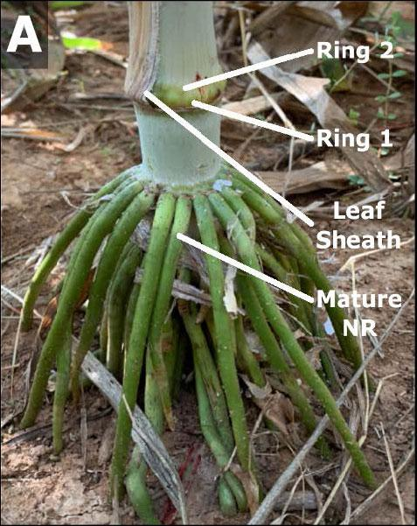
Study advances understanding of nodal root bud development in energy sorghum
Background/Objective
Bioenergy sorghum is a drought-tolerant crop that can produce biomass for forage, biofuels, and sustainable alternatives to petrochemicals. A system of about 175 nodal roots extending more than 2 meters deep and associated microbial communities enable the plants to absorb water and nutrients while sequestering carbon in soil, which contribute to the plant’s resilience and sustainability. This study sought to increase understanding of the nodal root system.
Approach
Researchers used microscopy, transcriptome analysis, and gene regulatory network analysis to study nodal root bud initiation and development in bioenergy sorghum hybrids grown at the Texas A&M University Farm.
Results
Two adjacent rings of 10-15 nodal root buds form on >20 stem nodes at different times during stem and plant development. Transcriptome analysis identified sorghum homologs of genes known to regulate nodal root initiation (e.g., WOX4) and genes required for root bud development (e.g., LBD29, SMB1). Gene regulatory network analysis identified connections between genes, hormonal inputs, and peptide signaling that modulate root bud development. These descriptions will aid in modulating the extent of nodal root bud formation and outgrowth.
Anatomy of nodal root buds
Significance/Impacts
Agriculture is one of the largest sources of greenhouse gas emissions. Soils represent one of the Earth's largest carbon sinks, yet in areas of intense cropping roughly half of soil organic carbon (SOC) has been lost in the past century. Restoring SOC levels could increase crop productivity and slow the rate of atmospheric CO₂ levels. Optimizing root production, distribution in soil profiles, and root-microbiome interactions that contribute to SOC accumulation is critical for sustainable production of biomass for low-carbon intensity biofuels and products.
Lamb, A., et al. Bioenergy Sorghum Nodal Root Bud Development: Morphometric, Transcriptomic and Gene Regulatory Network Analysis. Frontiers in Plant Science, 15. (2024). [DOI:10.3389/fpls.2024.1456627]

